Slide 1
La información mostrada durante la reunión está dirigida exclusivamente a Profesionales Sanitarios facultados para prescribir o dispensar medicamentos. Por favor no distribuir en medios, soportes o canales de comunicación dirigidos a público general.
Para la notificación de reacciones adversas puede dirigirse a la dirección de AstraZeneca: www.contactazmedical.astrazeneca.com
ES-41293 octubre 2025

Slide 2
IMPORTANCIA DEL COMITÉ MULTIDISCIPLINAR
Y CLAVES PARA EL DIAGNÓSTICO
T. Macarulla
Medical Oncology Department, Clínic Barcelona Comprehensive Cancer Center, Hospital Clínic Barcelona
Translational Oncology in Upper Gastrointestinal Cancer Group, IDIBAPS
Departament of Medicine, University of Barcelona

Slide 3
DISCLOSURES
Consultant or Advisory Role
Amgen, Servier, Incyte, Sanofi, AstraZeneca, Taiho, Celgene, Eisai
Institutional financial interests (financial support to research projects):
Celgene, AstraZeneca, BeiGene, Incyte
Non-financial interests:
AstraZeneca, Incyte, Servier, Roche, Eisai, MSD

Slide 4

BTC - Delayed Diagnosis: An Ongoing Issue¹
35 patients: iCCA (42.9%), dCCA (17.1%), gallbladder (14.3%), ampullary (14.3%) and pCCA (11.4%)
Majority of patients (60%) had metastases at diagnosis. Only 37.1% had surgery and 17.1% did not receive any treatment
1. Martirena et al. Presented at the 2025 CCF congress in Salt Lake City, USA from 9-11 April 2025

Slide 5
BTC - Delayed Diagnosis: an Ongoing Issue¹
Majority (51.4%) of patients were diagnosed through PC and 45.7% in the ED
Median time from symptom onset to diagnosis was 2.29 months (3.28mo for PC and 1,28mo for ED; p=0.39)
BTC, biliary tract cancer; ED, emergency department; PC, primary care
1. Martirena et al. Presented at the 2025 CCF congress in Salt Lake City, USA from 9-11 April 2025

Slide 6

BTC - Delayed Diagnosis: an Ongoing Issue
Most frequent symptoms were unspecific
Longest diagnostic delay was in patients with asthenia/anorexia (median 8.09mo), followed by weight loss (4.61mo), dyspepsia (4.54mo), diarrhoea (3.64mo), pain (3.07mo).
Biliary tumours are often diagnosed at advanced stages due to significant diagnostic delays caused by non-specific symptoms
These delays limit curative treatment options and worsen prognosis
Improved early detection strategies and awareness are crucial to enhancing outcomes and survival rates
1. Martirena et al. Presented at the 2025 CCF congress in Salt Lake City, USA from 9-11 April 2025

Slide 7
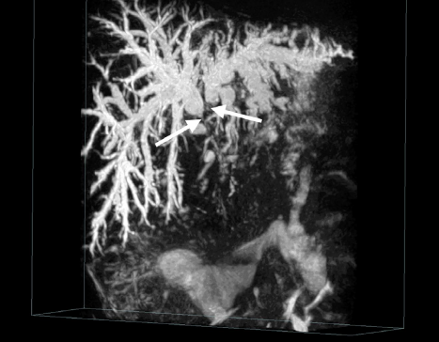
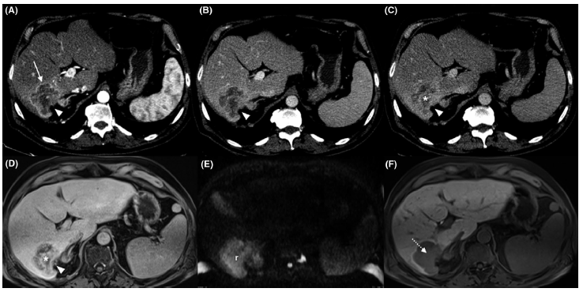
Challenges for Diagnosis¹
Hilar CCA
Differential diagnosis
  eCCA vs ampulla vs head of the pancreas (if distal)
  iCCA vs HCC vs CUP vs metastases
  Capsule retraction “pathognomonic”
  Challenges in cirrhotic patients​
  (vs HCC)
  Misdiagnosed as CUP (cancer of unknown primary)
1. Forner et al Liver Int 2019; 39: 98–107

Slide 8
Challenges for Diagnosis (vs CUP)
BTC represent a significant proportion of tumours classified as CUP
Non-liver involvement
228 patients with pCUP
Liver involvement
72 (32%) had malignancy involving the liver
24 (10.5%) patients had radiological features consistent with iCCA
Patients where a primary diagnosis was subsequently determined had better OS (10.2 months, p-values: iCCA = 0.0279, cCUP = 0.0230)
cCUP
Primary Tumor Diagnosis
N=4
Gynaecological
Renal
NSCLC
Colorectal
Hepatocellular
Other+
Sarcoma
N=11
N=3
cCUP
N=151
iCCA
N=24
Haematological
Head and neck
Prostate
Thyroid
Urothelial
Breast
N=2
N=7
Melanoma
Ovarian
Pancreatic
SCLC
N=1
Conway et al Br J Cancer 2022; 127: 531-540

Slide 9
DIAGNOSIS: ESMO GUIDELINES
ESMO guidelines for the diagnosis of CCA¹
Recommended diagnostic procedure | Purpose
Blood tests | Assess liver function Assess presence of underlying liver or biliary tract disease
ERCP/PTC ± biopsy or cholangioscopy | Assess and treat biliary obstruction Obtain tissue for diagnosis, classification, and NGS
EUS ± biopsy | Assess: locoregional extension of CCA; biliary obstruction; hepatic, vascular, and LN invasion; metastases Obtain tissue for diagnosis, classification, and NGS
MRI, including MRCP | Assess extension of CCA, including biliary tract and vascular anatomy, and identify hepatic metastases
CT scan of thorax + abdomen ± pelvis | Staging of tumor Detect local/distant lymphadenopathy and metastatic disease
PET CT | Identify nodal metastases, distant metastases, and disease recurrence
Current diagnosis by non-invasive approaches is not accurate enough, and histological confirmation is necessary²
1. Vogel A et al. Ann Oncol. 2023;34:127–140; 2. Banales JM et al. Nat Rev Gastroenterol Hepatol. 2020;17:557–588

Slide 10
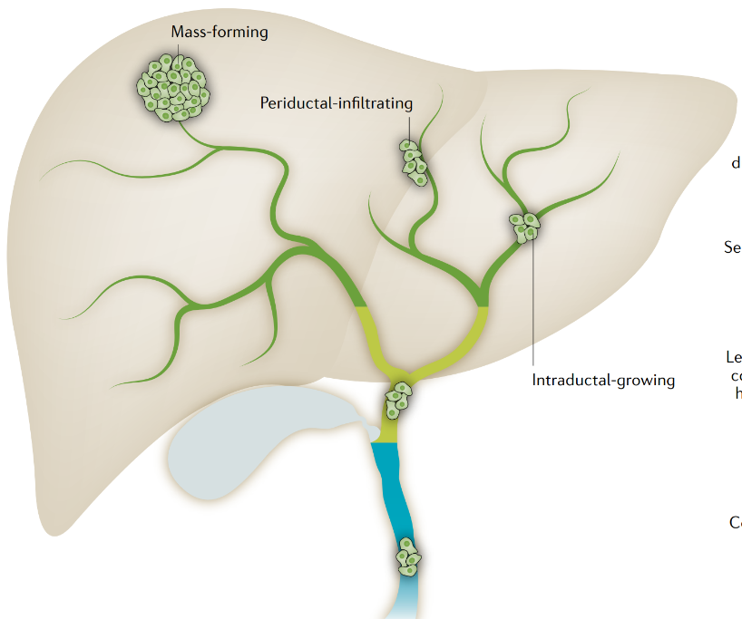
Classification of CCA: Histologic and molecular¹
Large bile duct
Commonly altered genes
Intrahepatic CCA
Small bile duct
iCCA
ARID1A, BAP1, BRAF, ERBB2(HER2), FGFR2, IDH1/2, KRAS, MDM2, NRAS, PBRM1, PIK3CA, SMAD4, TP53
Small-duct-type
BAP1, FGFR2, IDH1/2
Large-duct-type
KRAS, MDM2, SMAD4, TP53
Perihilar CCA
eCCA
ARID1A, ERBB2 (HER2), KRAS, SMAD4, TP53
Common
hepatic duct
Extrahepatic CCA
Gallbladder
Distal CCA
Common bile duct
1. Gopal P et al. Arch Pathol Lab Med (2024) 148(3):359–370.

Slide 11
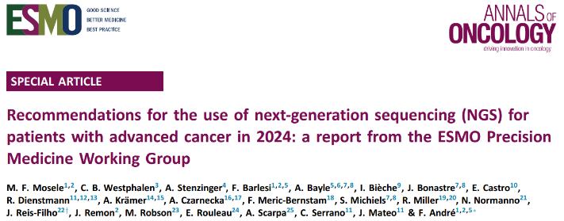
Classification of CCA: Targets¹⁻²
FGFR2 ^{RE}
9.4%
BRCA1/2
3.4%
IDH1
14.3%
BRAF^{non-V600E}
2.3%
MSI^{High}
1.2%
MET
2.2%
KRAS^{G12C}
1.1%
BRAF^{V600E}
2.3%
FGFR2^{Mut}
2.2%
TMB^{High}
3.7%
IDH2
4%
ERBB2^{Mut}
1.6%
ERBB2^{Amp}
3.8%
List of genomic alterations level I/II according to ESCAT in advanced cholangiocarcinoma
Gene | Alteration | Estimated prevalence | ESCAT score | Drug class matched | References
IDH1 | Mutations | 8%-18% iCCA | IA | IDH1 inhibitors | Abou-Alfa et al., Lancet Oncol 2020⁴
FGFR2 | Fusions | 5%-15% iCCA | IB | Pan-FGFR TKIs | Javle et al., J Clin Oncol 2018⁵ Abou-Alfa et al., Lancet Oncol 2020⁴ Pant et al., J Clin Oncol 2023⁶ Goyal et al., N Engl J Med 2023⁷
ERBB2 | Amplifications | 10%-20% dCCA,pCCA,GBC | IB | Anti-HER2 monoclonal antibodies Anti-HER2 ADCs Anti-HER2 bispecific antibodies HER2 TKIs | Javle et al., J Clin Oncol 2021⁵ Meric-Bernstam et al., JCO 2023⁸ Harding et al., Lancet Oncol 2023⁹ Nakamura et al., J Clin Oncol 2021¹⁰
 | Mutations | 3%-5% | IIB | Anti-HER2 monoclonal antibodies Pan-HER2 TKIs | Hyman et al., Nature 2018¹¹ Cannon et al., J Clin Oncol 2023 Harding et al., Nat Comm 2023⁹
BRAF | Mutations (p.V600E) | 50% | IB | BRAF inhibitors + MEK inhibitors | Subbiah et al., Lancet Oncol 2020¹² Salama et al., J Clin Oncol 2020¹³ Subbiah et al., Nature Med 2023¹⁴
KRAS | Mutations (p. G12C) | <1% | IC | KRAS ^{G1C2} TKIs | Bekail-Saab et al., J Clin Oncol 2022¹⁵
MDM^{Amp}
4.3%
Kendre G, et al³
ESCAT, ESMO Scale for Clinical Actionability of molecular Targets (ESCAT); dCCA, distal cholangiocarcinoma; iCCA, intrahepatic cholangiocarcinoma; pCCA, perihilar cholangiocarcinoma
1. Mosele MF et al. Ann Oncol. 2024 Jul;35(7):588-606 2. Lamarca A et al. J Hepatol. 2020 Jul;73(1):170-185 3. Kendre G, et al. J Hepatol. 2022;3:614-626. 4. Abou-Alfa GK et al. Lancet Oncol. 2020 May;21(5):671-684 5. Javle M et al. J Clin Oncol. 2018 Jan 20;36(3):276-282 6. Pant S et al. JCO. 2023;41:4008 7. Goyal L et al. N Engl J Med. 2023 Jan 19;388(3):228-239 8. Meric-Bernstam F et al. J Clin Oncol. 2024 Jan 1;42(1):47-58 9. Harding JJ et al. Lancet Oncol. 2023 Jul;24(7):772-782 10. Nakamura R et al. J Clin Oncol. 2021 Oct 20;39(30):3328-3339 11. Hyman DM et al. Nature. 2019 Feb;566(7745):E11-E12 12. Subbiah V et al. Lancet Oncol. 2020 Sep;21(9):1234-1243 13. Salama AKS et al. J Clin Oncol. 2020 Nov 20;38(33):3895-3904 14. Subbiah V et al. Nat Med. 2023 May;29(5):1103-1112 15. Bekaii-Saab T et al. J Clin Oncol. 2023 Sep 1;41(25):4097-4106

Slide 12

BTC 2025 ESMO Guidelines¹
BTC
Unfit for surgery, liver-limited iCCA:
RFA (<3 cm) [III, B]
SBRT [III, C]
Early stage
Locally advanced
Advanced or metastaticª
Molecular profiling
Molecular profiling^{b}
Surgery^{c} [III, A]
Responders
Via MDT
Clinical trials where possible
Cisplatin–gemcitabine–durvalumab^{d} [I, A] Cisplatin–gemcitabine–pembrolizumab^{d} [I,A]
Cisplatin–gemcitabine–durvalumab^{e} [I, A] Cisplatin–gemcitabine–pembrolizumab^{e} [I,A]
Adjuvant
capecitabine
[II, A]
Wherever possible, NGS testing should be performed early, preferably at first diagnosis and initiation of first-line systemic therapy for advanced disease, so that if/when first-line systemic treatment fails, second-line treatment targeting identified actionable genomic alterations can be initiated without delay¹.
Liver-limited iCCA:^{f}
local therapy [III, A]
All comers
FOLFOX^{g}
[I, A; MCBS 1]^{h}
Alternative: 5-FU ± irinotecan [II, C]
Surveillance
IDH1 mutation
[ESCAT I-A]^{i}
FGFR2 fusion or rearrangement
[ESCAT I-B]^{i}
BRAF^{V600E} mutation
[ESCAT I-B]^{i}
MSI-H/dMMR [ESCAT I-C]^{i}
HER2 overexpression and/or HER2 amplification
[ESCAT I-C]^{i}
NTRK fusion
[ESCAT I-C]^{i}
RET fusion
[ESCAT I-C]^{i}
BRCA1/2 or PALB2
mutation
[ESCAT III-A]^{i}
▼Futibatinib
[III, A; MCBS 3]^{h}
▼Pemigatinib
[III, A; MCBS 2]^{h}
▼Trastuzumab deruxtecan^{j}
[III, A; MCBS 3]^{h}
Zanidatamab^{j}
[III, A; MCBS 3]^{h}
Entrectinib
[III, A; MCBS 3]^{h}
▼Larotrectinib
[IlI, A; MCBS 3]^{h}
▼Repotrectinib^{m}
[III, A]
▼Ivosidenib
[I, A; MCBS 2]^{h}
Dabrafenib- trametinib^{j}
[III, A; MCBS 3]^{h}
Pembrolizumab^{k,l}
[III, A; MCBS 3]^{h}
▼Selpercatinib
[III, A; MCBS 3]^{h}
PARP inhibitors [V,B]
5-FU, 5-fluorouracil; BRAF, v-Raf murine sarcoma viral oncogene homolog B gene; BRCA1/2, BReast CAncer gene 1/2; BTC, biliary tract cancer; dMMR, mismatch repair deficiency; ESCAT, ESMO Scale for Clinical Actionability of Molecular Targets; FGFR2, fibroblast growth factor receptor 2; FOLFOX, 5-fluorouracil + leucovorin + oxaliplatin; HER2, human epidermal growth factor receptor 2; iCCA, intrahepatic cholangiocarcinoma; IDH1, isocitrate dehydrogenase 1; MCBS, ESMO-Magnitude of Clinical Benefit Scale; MDT, multidisciplinary team; MSI-H, microsatellite instability-high; NTRK, neurotrophic tyrosine receptor kinase; PALB2, partner and localizer of BRCA2; PARP, poly (ADP-ribose) polymerase; RET, rearranged during transfection gene; RFA, radiofrequency ablation; SBRT, stereotactic body radiotherapy. ▼ Este medicamento está sujeto a seguimiento adicional, lo que agilizará la detección de nueva información sobre su seguridad. Se invita a los profesionales sanitarios a notificar las sospechas dereacciones adversas. This medicine is subject to additional monitoring, which will expedite the detection of new safety information. Healthcare professionals are encouraged to report suspected adverse reactions. Capecitabina no esta indicado en el tratamiento del cáncer de vías biliares/ Capecitabine is not indicated in the treatment of bile tract cancer. Pembrolizumab en combinación con gemcitabina y cisplantin no está indicado para el tratamiento del cáncer de vías biliares en España / Pembrolizumab in combination with gemcitabine and cisplatin is not indicated for the treatment of bile tract cancer in Spain/FOLFOX no esta indicado en el tratamiento del cáncer de vías biliares/ FOLFOX is not indicated in the treatment of bile tract cancer. La combinación 5-FU + irinotecán no está indicada para el tratamiento del cáncer de vías biliares / Combination of 5-FU + irinotecan is not indicated in the treatment of bile tract cancer. Dabrafenib en combinación con trametinib no está indicado para el tratamiento del cáncer de vías biliares/ Dabrafenib in combination with trametinib is not indicated for the treatment of bilary tract cancer. Trastuzumab deruxtecan no está indicado para el tratamiento de cáncer de vías biliares / Trastuzumab deruxtecan is not indicated for the treatment of bilary tract cancer. Zanidatamab no está comercializado en España / Zanidatamab is not marketed in Spain. Repotrectinib no está comercializado en España / Repotrectinib is not marketedin Spain. ​
1. Vogel A, Ducreux M. ESMO Open 2025;10:104003

Slide 13


ESMO Guidelines/Molecular Diagnosis
Currently, the gene panel should include the respective coding DNA/RNA regions (target regions) of:
IDH1
FGFR2
BRAF to test for hotspot mutations
Microsatellite instability (MSI) status can be inferred by an immunohistochemistry (IHC), PCR based tests or NGS
NTRK
HER2
HER2 tested by IHC methodology
DNA, deoxyribonucleic acid; IDH1, isocitrate dehydrogenase-1; IHC, immunohistochemistry; NGS, new-generation sequencing; PCR, polymerase chain reaction; RNA, ribonucleic acid;
1. ESMO Guidelines Committee. ESMO clinical practice guidelines. Sept 2016.

Slide 14
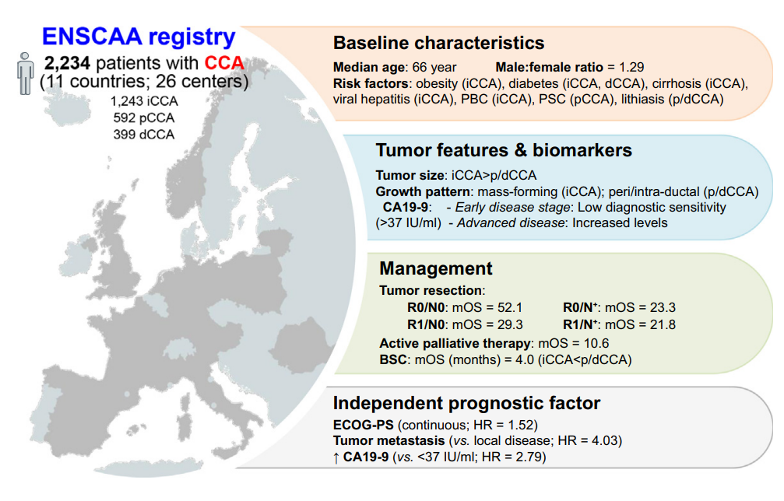
BTC –Risk Factors
Baseline patient characteristics and concomitant conditions
Izquierdo-Sánchez et al, Journal of Hepatology 2022 vol. 76 j 1109–1121

Slide 15
Multidisciplinary Tumour board in BTC
Aim: to define the current practice of MDTs in CCAs and identify possible areas of improvement, providing minimum standards of practice for an ideal CCA-MDT.
There are currently no standardized guidelines for MDTs in CCAs¹
ENS-CCA led an online survey (34 institutions)¹
1. Casadio et al ESMO Open 2022; 7: 100377

Slide 16
Multidisciplinary Tumour Board in BTC
CCA-MDT: ENS-CCA Recommendations
 | Current practice is adequate
 | Current practice could be improved
 | Current practice requires improvement
ENS-CCA recommendations for CCA MDT
Recommendations¹
MDT coordinator | Presence of MDT coordinator should be mandatory for a well-functioning MDT
Frequency | The MDT should meet weekly. In scenarios of worsening obstructive jaundice or hospitalization in need of urgent review and discussion, an Ad hoc same-day multidisciplinary discussion should be considered for staging, determining resectability and the corresponding segments that require urgent drainage.
Referral | Patients should be referred online to the MDT discussion via standard platform or email
Patient information | Information should be provided before the discussion in order to allow radiologists to prepare properly the case and the images
Discussion criteria | Each new patient and each new treatment should be discussed
Type of MDT | Patients with CCA should be discussed in MDTs dedicated to liver cancers only. Whenever possible, centralisation of care/MDTs within a region is recommended to secure adequate experienced decision making.
Guidelines | Guidelines should be used for diagnosis and treatment decision making. Our preference is to use national guidelines, more aware of locally accessible treatment options
Mandatory aspects to be discussed | Collective discussion of diagnostic decision and treatment, patients' preferences and supportive care needs should be mandatory
Mandatory specialists | Presence of the oncologist, clinician responsible for the patient's care, surgeon, diagnostic and interventional radiologist, hepatologist, pathologist, endoscopist and gastroenterologist should be mandatory in a well-functioning MDT
Desirable specialists | Presence of palliative, nurse and dietitian, basic researcher, psychologist and social worker should be recommended
SETUP
-Presence of MDT coordinator
-Minimum information submitted before MDT discussion
-Only Liver cancer MDT
GUIDELINES
-Guidelines should be used for decision making
-Preference for national guidelines, but awareness for international
FREQUENCY AND REFERRAL
-Weekly
-Online platform/email
-Discussion of every new patient and every new treatment
WELL-FUNCTIONING MDT¹
SPECIAL TIES
Surgeon, oncologist, radiologist, hepatologist, gastroenterologist, pathologist
Endoscopist, nurse, psychologist, basic researcher
Dietitian, palliative care, social worker
COLLECTIVE DISCUSSION
-Diagnosis and every new treatment decision
-Patients' supportive care needs
-Patients' preferences
1. Casadio et al ESMO Open 2022; 7: 100377

Slide 17

Multidisciplinary care is key to the effective diagnosis and management of BTC¹⁻²
Gastroenterologist
Resectable
patients
Surgeon
Internal medicine /
hepatologist
Pathologist
General Practitioner
MDT^{1,2}
Neoadjuvant
treatment
Advanced
patients
Radiologist
MTB
Palliative care
Medical oncologist
1. Vogel A, et al. Ann Oncol 2023;34: 127–140; 2. NCCN Guidelines 2023. https://www.nccn.org/professionals/physician_gls/pdf/btc.pdf Accessed May 2023

Slide 18
Additional considerations for the management of BTC¹⁻³
Gastroenterologist
ECOG performance status¹
Associated co-morbidities¹
Patient preference¹
Disease-related factors
Disease stage¹
Vascular infiltration¹
Presence of distal metastases¹
Tumour gene expression profile¹ and mutational burden²
Specialist availability
High-volume expert centres (linked to lowered mortality and better patient outcomes for liver resection)³
1. Valle JW, et al. Lancet 2021;397:428–444. 2. Bridgewater JA, et al. Am Soc Clin Oncol Educ Book 2016;35:e194–e203. 3. Filmann N, et al. BJS 2019; 106:1523-1529.

Slide 19
Conclusion
Cholangiocarcinoma diagnosis remains a complex challenge¹
This challenge of late diagnosis in biliary tract cancers highlights a critical need: multidisciplinary team consultation must begin at suspicion, not confirmation²⁻³
Every new patient and each new treatment should be discussed collectively, including diagnosis, treatment decisions, patient preferences, and supportive care needs²⁻³
The MDT should include an oncologist, clinician responsible for the patient's care, surgeon, diagnostic and interventional radiologist, hepatologist, pathologist, endoscopist, and gastroenterologist²⁻³
Differentiating CCA from other hepatic or metastatic lesions, including CUP, often requires the combined expertise of radiologists, pathologists, and hepatobiliary specialists, further reinforcing the need for MDTs²⁻³
National guidelines should be used for diagnosis and treatment decision-making, with awareness of international guidelines to offer the best possible care⁴
1. Martirena et al. Presented at the 2025 CCF congress in Salt Lake City, USA from 9-11 April 2025 2. Vogel A, et al. Ann Oncol 2023;34: 127–140; 3. NCCN Guidelines 2023. https://www.nccn.org/professionals/physician_gls/pdf/btc.pdf Accessed May 2023 4. Vogel A, Ducreux M. ESMO Open 2025;10:104003

