Slide 1
La información mostrada durante la reunión está dirigida exclusivamente a Profesionales Sanitarios facultados para prescribir o dispensar medicamentos. Por favor no distribuir en medios, soportes o canales de comunicación dirigidos a público general.
Para la notificación de reacciones adversas puede dirigirse a la dirección de AstraZeneca: www.contactazmedical.astrazeneca.com
ES-41295 Marzo 2026

Slide 2
Optimal Mangemnet of Biliary Strictures
ANDRES CARDENAS, MD, MMSc, PhD, AGAF, FAASLD
Faculty Member & Consultant
Institute of Digestive Diseases & Metabolism
Hospital Clinic - Barcelona
Associate Professor of Medicine, University of Barcelona

Slide 3
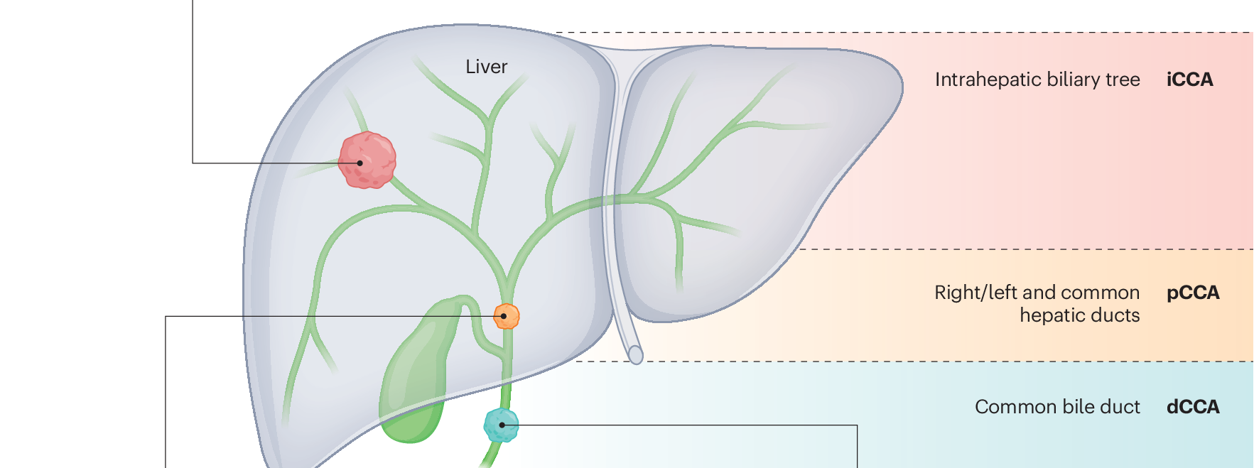
CHOLANGIOCARCINOMA - CCA
Imaging/Liver biopsy
ERCP / cholangioscopy biopsy
ERCP / Cholangioscopy
EUS biopsy
Cholangiocarcinoma 2026: status quo, unmet needs and priorities. Nat Rev Gastroenterol Hepatol. 2026 Jan;23(1):65-96

Slide 4
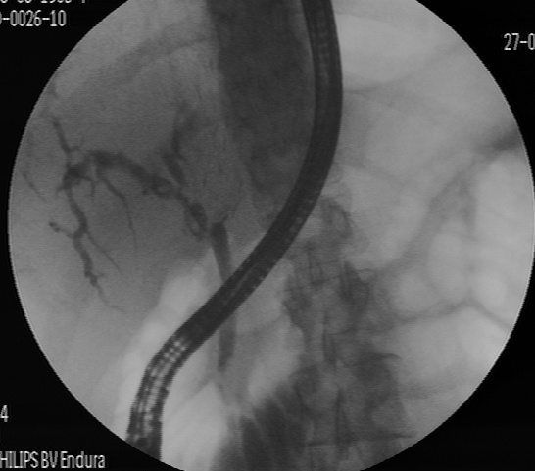
Biliary Strictures are a Baffling situation
Distinguishing between benign and malignant strictures remains extremely challenging.
CT scan / MRCP/ tumor markers always first
Biliary strictures in adults are more likely to be malignant than benign except in certain well-defined scenarios.
It is key to obtain adequate tissue for diagnosis.
Benign or Malignant?
Cholangiocarcinoma 2026: status quo, unmet needs and priorities. Nat Rev Gastroenterol Hepatol. 2026 Jan;23(1):65-96.

Slide 5
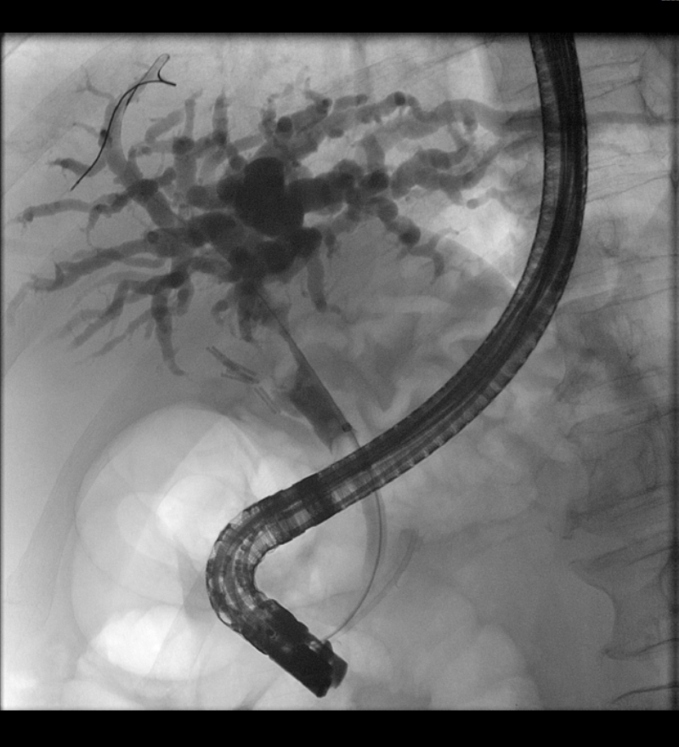
ERCP and CCA
ERCP is pivotal in the treatment of patients with CCA:
Acquiring tissue for cytological or histological diagnosis
Facilitating biliary drainage in selected patients
Providing a valuable palliative tool in cases deemed inoperable
Cholangiocarcinoma 2026: status quo, unmet needs and priorities. Nat Rev Gastroenterol Hepatol. 2026 Jan;23(1):65-96.

Slide 6
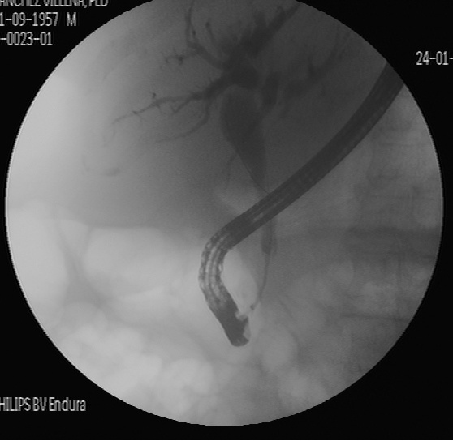
Distal biliary strictures
In patients with an extrahepatic biliary stricture due to an apparent or suspected CCA on imaging:
  EUS with fine-needle sampling (aspiration or biopsy; FNA/B) or ERCP as the preferred method of evaluating for malignancy.
  Single-session EUS and ERCP recommended for concurrent diagnosis and drainage.
  Cholangioscopy has high specificity and sensitivity.
ACG Clinical Guideline: Diagnosis and Management of Biliary Strictures. Am J Gastroenterol. 2023 Mar 1;118(3):405-426

Slide 7
Perihilar biliary strictures
MRCP / CT scan
EUS → low diagnostic yield in hilar / perihilar biliary strictures
ERCP with Tissue Acquisition!
  Brush cytology
  Fluoroscopy-guided biopsies
  Cholangioscopy
Sensitivity:
Brush cytology alone <40-56%%
Fluoroscopy-guided biopsies alone 49-50%
Cytology brushing + biopsies 66-71%
The pooled sensitivity 66-72% and specificity 97-98%
Pooled diagnostic odds ratio to detect cholangiocarcinoma is 59
Rushbrook, S. M. et al. British Society of Gastroenterology guidelines for the diagnosis and management of cholangiocarcinoma. Gut 73, 16–46 (2023)

Slide 8
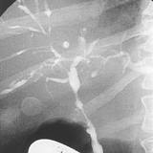
Cholangiocarcinoma
Suspected malignant perihilar stricture due to cholangiocarcinoma:
  EUS-FNA/B and percutaneous biopsy of the primary lesion (perihilar stricture or mass) should be avoided: (seeding)
  Instead, intraductal sampling should be favored.
  EUS-FNA/B (or percutaneous biopsy) should only be performed to sample associated lymphadenopathy.
ERCP features suggestive of malignancy stricture:
  Length > 10 mm
  Irregular margins
  Abrupt transition from normal duct to stricture.
Tissue multimodality: combine!
  Cytology brush
  Fluoroscopy-guided biopsies
  Biopsies under direct vision → Cholangioscopy
Dorrell R, Pawa S, Zhou Y, Lalwani N, Pawa R. The diagnostic dilemma of malignant biliary strictures. Diagnostics (Basel) [Internet]. 2020;10(5):337. Disponible en: http://dx.doi.org/10.3390/diagnostics10050337

Slide 9
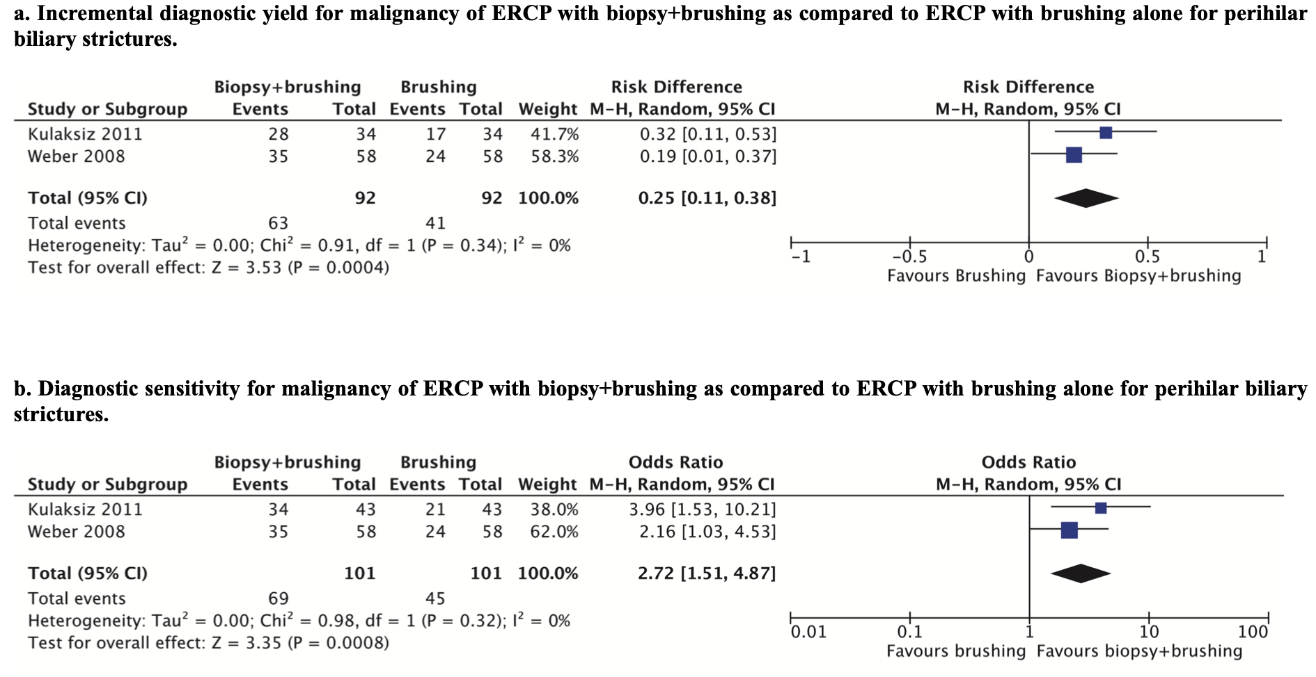
Hilar biliary strictures
European Society of Gastrointestinal Endoscopy (ESGE) Guideline. Endoscopy. 2024 Dec 17.

Slide 10
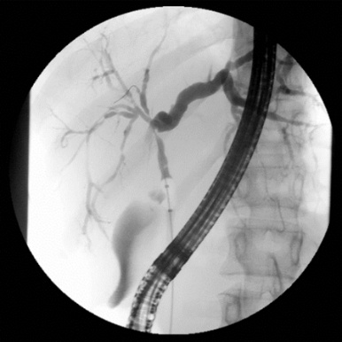
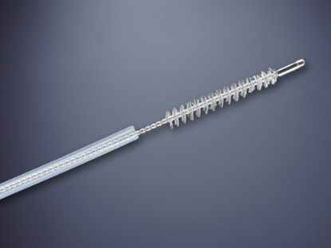
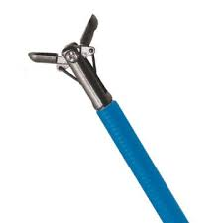
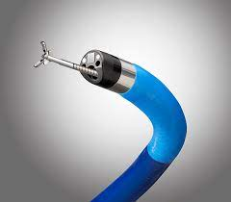
Perihilar biliary strictures
  Multimodality sampling over brush cytology alone.
  At least 2 diagnostic sampling modalities, but there is a rationale to use 3-4 combined at the time of initial evaluation.
ACG Clinical Guideline: Diagnosis and Management of Biliary Strictures. Am J Gastroenterol. 2023 Mar 1;118(3):405-426
European Society of Gastrointestinal Endoscopy (ESGE) Guideline. Endoscopy. 2024 Dec 17.

Slide 11
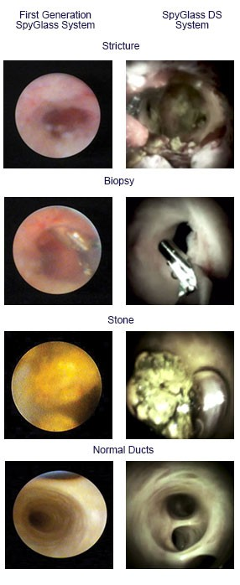
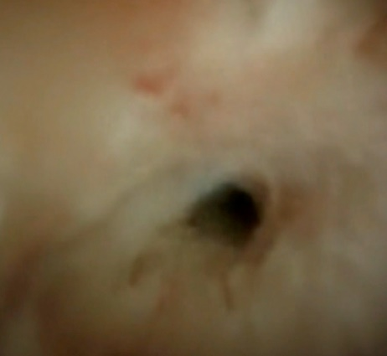
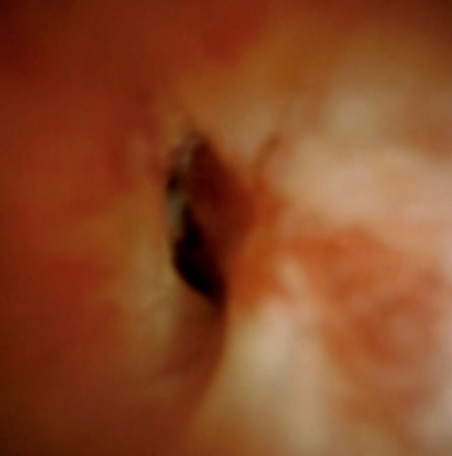
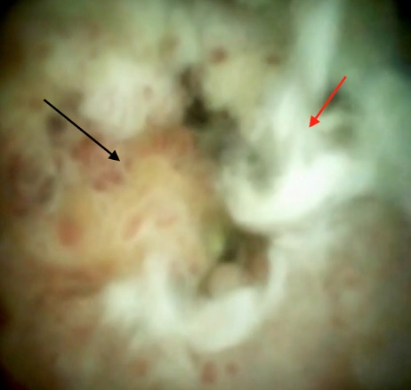
Suspected cholangiocarcinoma or indeterminate
Cholangioscopy
ERCP standard modalities + cholangioscopy.
Incremental yield of cholangioscopy-guided biopsies around 25-30%.
Sensitivity rises from 50% to 75%.
Normal
Stricture
Stricture & inflammation / dysplasia
CCA
Dorrell R, Pawa S, Zhou Y, Lalwani N, Pawa R. The diagnostic dilemma of malignant biliary strictures. Diagnostics (Basel) [Internet]. 2020;10(5):337. Disponible en: http://dx.doi.org/10.3390/diagnostics10050337

Slide 12
Digital Cholangioscopy and AI
Robles-Medranda. Endoscopy 2022.

Slide 13
Drainage of biliary strictures
Aim → Restore the bile flow into the duodenum.
Substantial variability in the difficulty and risk of achieving drainage.
Generally, drainage of hilar strictures is more challenging compared with extrahepatic strictures.
Goals:
  Alleviate symptoms
  Reduce serum bilirubin in which chemo can be safely administered (< 2.5 mg/dL)
  Optimize surgical outcomes
Rushbrook, S. M. et al. British Society of Gastroenterology guidelines for the diagnosis and management of cholangiocarcinoma. Gut 73, 16–46 (2023)

Slide 14
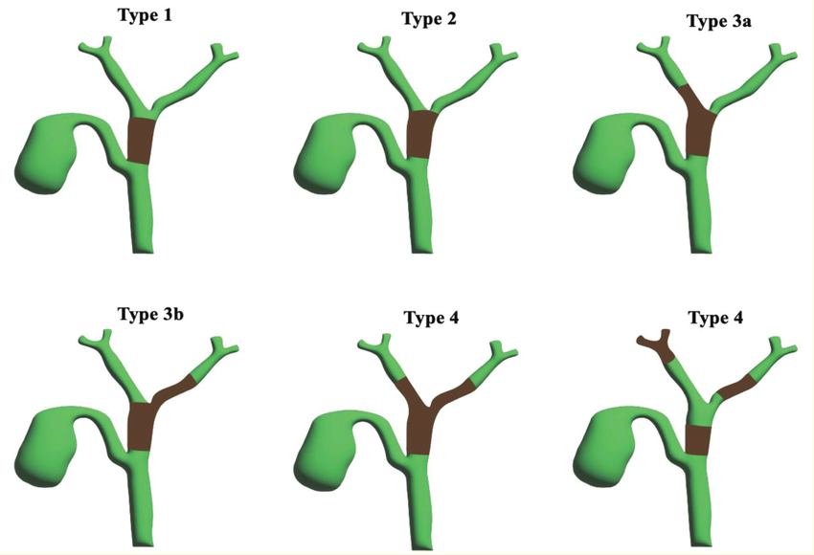
Drainage of biliary strictures
BISMUTH CORLETTE
CLASSIFICATION
Dorrell R, Pawa S, Zhou Y, Lalwani N, Pawa R. The diagnostic dilemma of malignant biliary strictures. Diagnostics (Basel) [Internet]. 2020;10(5):337. Disponible en: http://dx.doi.org/10.3390/diagnostics10050337

Slide 15
Biliary drainage
Distal malignant strictures
A) Resectable lesions:
  Surgery must be the target
  ERCP + stent is the preferred treatment if biliary drainage is needed
Important questions before endoscopic drainage:
  Is the patient a surgical candidate?
  Is the patient candidate to neoadjuvant therapy?
  Is the patient candidate for palliative care?
ACG Clinical Guideline: Diagnosis and Management of Biliary Strictures. Am J Gastroenterol. 2023 Mar 1;118(3):405-426
European Society of Gastrointestinal Endoscopy (ESGE) Guideline. Endoscopy. 2024 Dec 17.

Slide 16
Pre-operative biliary drainage
Distal malignant strictures
Guidelines advise against the use of routine PBD in patients with an extrahepatic malignant stricture due to resectable cholangiocarcinoma.
PBD warranted in selected patients:
Acute cholangitis
Bilirubin levels > 14.6 mg/dl
Intractable pruritus
Neoadjuvant therapy if jaundice is present
Expected delay in surgery > 3-4 weeks
If PBD needed
ERCP + fully-covered metal stent (SEMS)
ACG Clinical Guideline: Diagnosis and Management of Biliary Strictures. Am J Gastroenterol. 2023 Mar 1;118(3):405-426

Slide 17
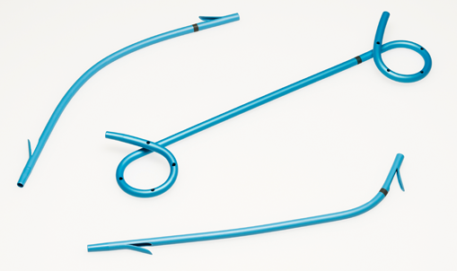
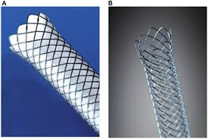
Drainage of malignant biliary strictures
Distal malignant strictures
B) Borderline resectable or unresectable:
  ERCP is the preferred modality if drainage is needed
  In the last 5-10 years → EUS-BD has emerged as an option (more data needed)
Both Plastic stents and metal (SEMS) are effective for initial relief of biliary obstruction.
Metal SEMS provide a longer patency and reduce cholangitis events
SEMS preferred over Plastic Stents
ACG Clinical Guideline: Diagnosis and Management of Biliary Strictures. Am J Gastroenterol. 2023 Mar 1;118(3):405-426
European Society of Gastrointestinal Endoscopy (ESGE) Guideline. Endoscopy. 2024 Dec 17.

Slide 18
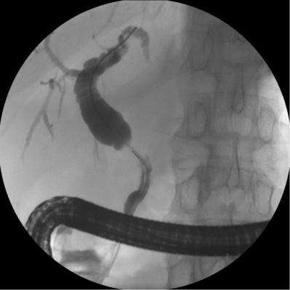
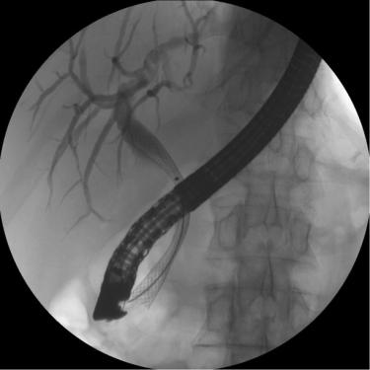
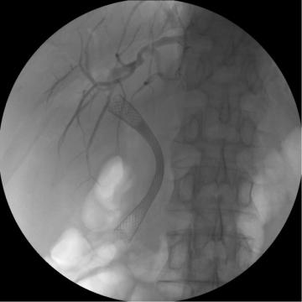
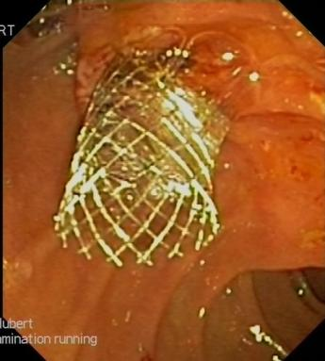
Distal malignant biliary obstruction drained with SEMS

Slide 19
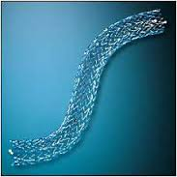
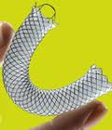
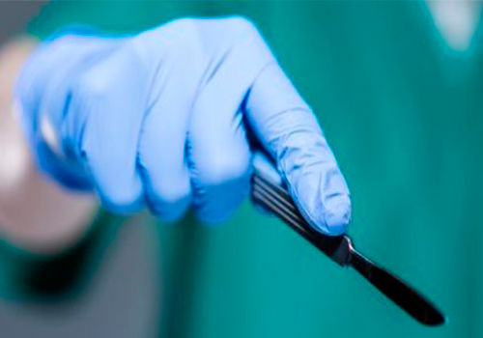
Distal malignant biliary obstruction
Borderline resectable / unresectable
Resectable
Surgery in < 4 w
YES
NO
No surgery expected
Surgery expected after neoadjuvant therapy
Bil ≤ 14.6 mg/dL
Bil > 2.3 mg/dL
ERCP +
Uncovered SEMS
ERCP +
Fully-covered SEMS
Surgery
ERCP +
Fully-covered SEMS
Dorrell R, Pawa S, Zhou Y, Lalwani N, Pawa R. The diagnostic dilemma of malignant biliary strictures. Diagnostics (Basel) [Internet]. 2020;10(5):337. Disponible en: http://dx.doi.org/10.3390/diagnostics10050337

Slide 20
Drainage of malignant biliary strictures
Hilar / perihilar malignant strictures
A) Resectable lesions:
  Surgery must be the target
  Pre-operative biliary drainage not always recommended.
  Unilateral drainage in the remnant lobe is considered before surgery.
Drainage warranted in selected patients:
Acute cholangitis
Bilirubin levels > 14.6 mg/dl
Intractable pruritus
Neoadjuvant therapy if jaundice is present
Expected delay in surgery > 3-4 weeks
Dispositiva elaborada en base a la práctica clínica del Hospital Clínic de Barcelona

Slide 21
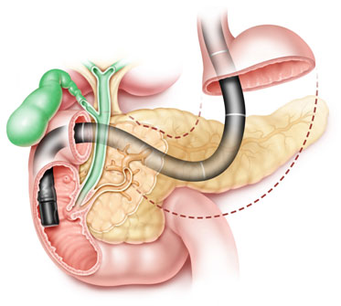
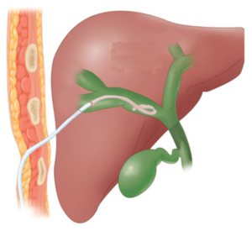
Drainage of malignant biliary strictures
Perihilar malignant strictures
Borderline lesions or unresectable:
  ERCP and PTBD (percutaneous drainage)
  Insufficient evidence to recommend for or against ERCP vs PTBD in patients with perihilar malignant strictures.
  Case-by-case. Discuss with all caretakers and patient.
Artifon ELA, Aparicio D, Paione JB, Lo SK, Bordini A, Rabello C, et al. Biliary drainage in patients with unresectable, malignant obstruction where ERCP fails: endoscopic ultrasonography-guided choledochoduodenostomy versus percutaneous drainage: Endoscopic ultrasonography-guided choledochoduodenostomy versus percutaneous drainage. J Clin Gastroenterol [Internet]. 2012;46(9):768–74. Disponible en: http://dx.doi.org/10.1097/MCG.0b013e31825f264c

Slide 22
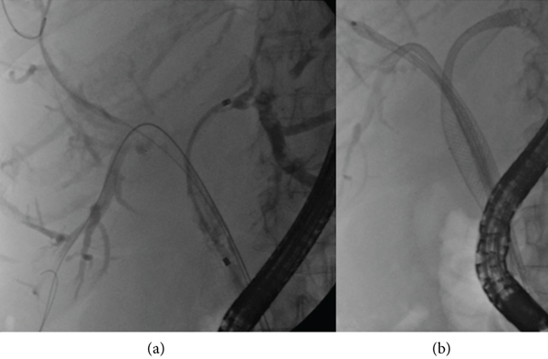
Drainage of malignant biliary strictures
Perihilar malignant strictures
Drainage in volumetric sectorial fashion and not only in terms of unilateral vs bilateral drainage.
The technical goal is to drain >50% of the non-atrophic liver, with each sector contributing roughly one-third of the liver's volume.
Bilateral stenting is typically reserved for patients with type IV Bismuth–Corlette strictures, those unresponsive to unilateral stenting
Remember to plan your endoscopy or PTC with a recent MRCP first!
Artifon ELA, Aparicio D, Paione JB, Lo SK, Bordini A, Rabello C, et al. Biliary drainage in patients with unresectable, malignant obstruction where ERCP fails: endoscopic ultrasonography-guided choledochoduodenostomy versus percutaneous drainage: Endoscopic ultrasonography-guided choledochoduodenostomy versus percutaneous drainage. J Clin Gastroenterol [Internet]. 2012;46(9):768–74. Disponible en: http://dx.doi.org/10.1097/MCG.0b013e31825f264c

Slide 23
Drainage of malignant biliary strictures
Perihilar CCA
Patients with unresectable pCCA with biliary obstruction should be considered for palliative stenting through either ERCP or percutaneous transhepatic cholangiography and drainage.
Borderline lesions or unresectable:
  When choosing ERCP:
    Insufficient evidence to recommend PS or metal SEMS.
  Two considerations:
    Many patients with unresectable perihilar stricture who receive uncovered SEMS will outlive the patency of their metal stents and repeat multiple ERCP or salvage PTDBD.
    Endoscopic reintervention to reestablish drainage through occluded uSEMS is particularly challenging.
Current shift to favor replaceable PS over uncovered SEMS
Artifon ELA, Aparicio D, Paione JB, Lo SK, Bordini A, Rabello C, et al. Biliary drainage in patients with unresectable, malignant obstruction where ERCP fails: endoscopic ultrasonography-guided choledochoduodenostomy versus percutaneous drainage: Endoscopic ultrasonography-guided choledochoduodenostomy versus percutaneous drainage. J Clin Gastroenterol [Internet]. 2012;46(9):768–74. Disponible en: http://dx.doi.org/10.1097/MCG.0b013e31825f264c

Slide 24
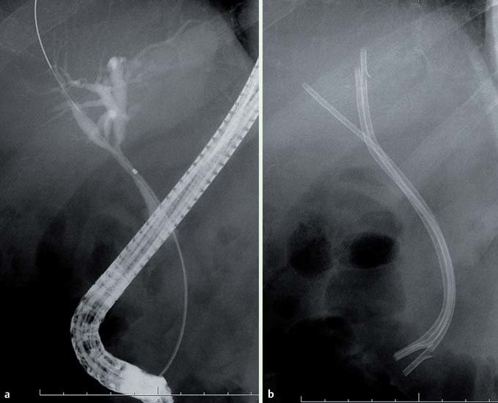

Slide 25
Perihilar malignant biliary obstruction
Borderline resectable / unresectable
Consideration of surgery
YES
NO
No surgery expected
Surgery expected after neoadjuvant therapy
Bil ≤ 14.6 mg/dL
Bil > 2.3 mg/dL
ERCP / PTBD
Uncovered SEMS or PS
ERCP +
Plastic stents
Surgery
ERCP +
Plastic stents
Dorrell R, Pawa S, Zhou Y, Lalwani N, Pawa R. The diagnostic dilemma of malignant biliary strictures. Diagnostics (Basel) [Internet]. 2020;10(5):337. Disponible en: http://dx.doi.org/10.3390/diagnostics10050337

