Slide 1
La información mostrada durante la reunión está dirigida exclusivamente a Profesionales Sanitarios facultados para prescribir o dispensar medicamentos. Por favor no distribuir en medios, soportes o canales de comunicación dirigidos a público general.
Para la notificación de reacciones adversas puede dirigirse a la dirección de AstraZeneca: www.contactazmedical.astrazeneca.com
ES-41294 octubre 2025

Slide 2
ACTUALIZACIÓN DE LA 1L DE TRATAMIENTO EN CÁNCER DE VÍA BILIAR IRRESECABLE O
METASTÁSICO
T. Macarulla
Medical Oncology Department, Clínic Barcelona Comprehensive Cancer Center, Hospital Clínic Barcelona
Translational Oncology in Upper Gastrointestinal Cancer Group, IDIBAPS
Departament of Medicine, University of Barcelona

Slide 3
DISCLOSURES
Consultant or Advisory Role
Amgen, Servier, Incyte, Sanofi, AstraZeneca, Taiho, Celgene, Eisai
Institutional financial interests (financial support to research projects):
Celgene, AstraZeneca, BeiGene, Incyte
Non-financial interests:
AstraZeneca, Incyte, Servier, Roche, Eisai, MSD

Slide 4


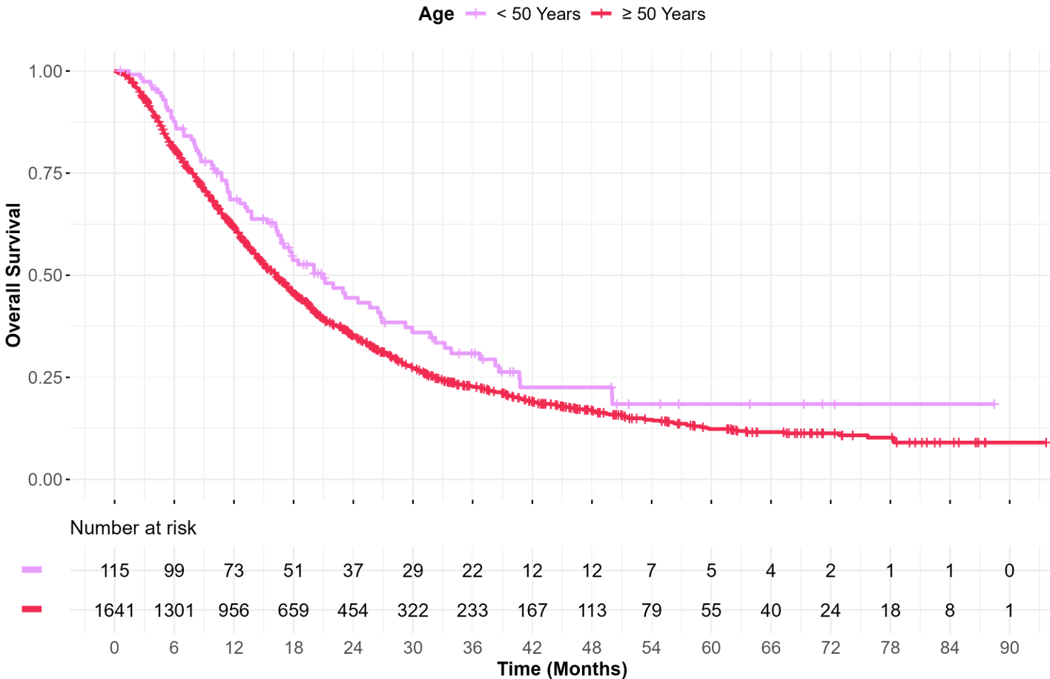
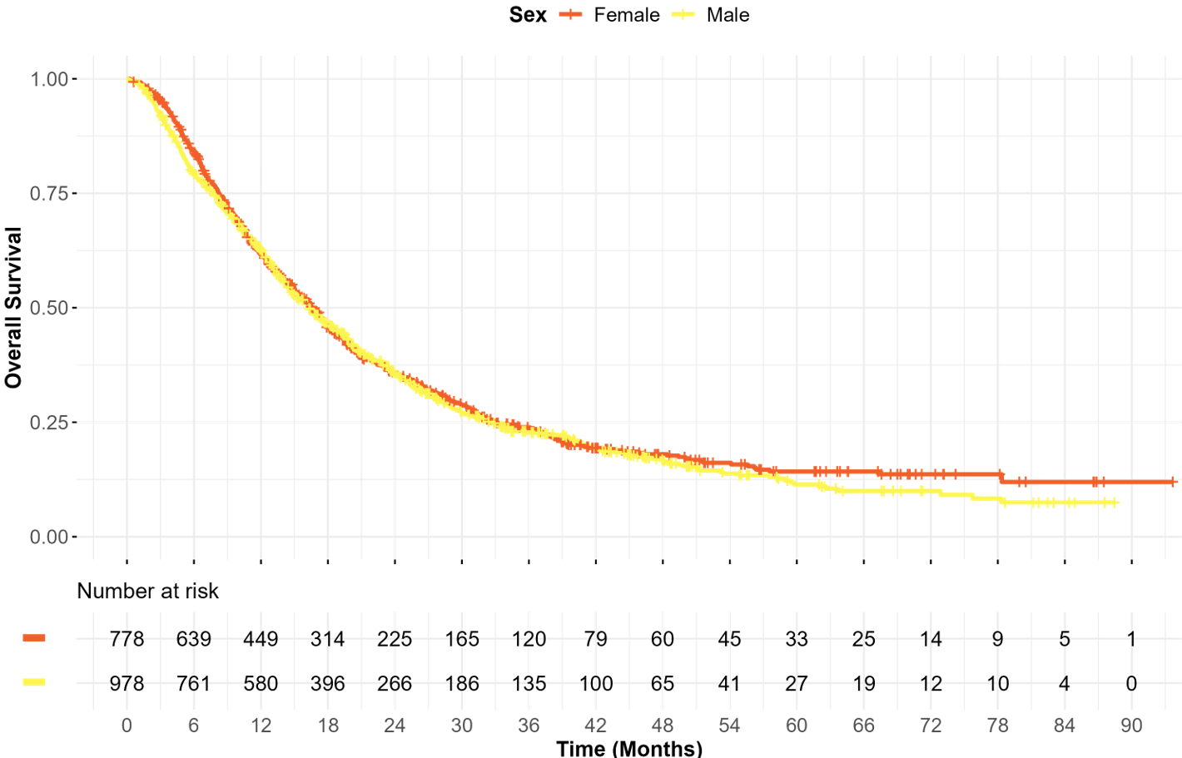
The Evidence vs Reality
Epidemiological characterization of BTC patients from the Spanish RETUD Registry¹
Biomarker information was provided in 591 (33.7%) patients, ESCAT-I alterations were found in 168 (28.4%) of them. Most frequent ESCAT-I alterations are presented in table 3.
Multicenter real-world study: a comprehensive characterization of biliary tract cancer epidemiology in Spain
Biomarker information: Frequent ESCAT-I alterations
1756 patients
40 hospitals
ESCAT-I | Biomarker determination (N) | Alteration [N (%)]
IDH1 mutation | 447 | 75 (16.8%)
FGFR2 fusion | 401 | 32 (8.0%)
MSI | 491 | 30 (6.1%)
HER2 ampl./overexpression | 449 | 25 (5.7%)
Variable | N = 1,756'
Age at primary tumor diagnosis [median (Q1, Q3)] | 68.6 (61.2, 74.9)
Sex (female) | 978 (55.7%)
Location of primary tumor
Intrahepatic | 931 (53.0%)
Gallbladder carcinoma | 272 (15.5%)
Extrahepatic distal | 253 (14.4%)
Extrahepatic hiliar | 226 (12.9%)
Ampulla of vater | 47 (2.7%)
Other | 27 (1.5%)
Chemotherapy | 1586 (90.3%)
Immunotherapy | 188 (10.7%)
Targeted therapy | 111 (6.3%)
Clinical trial | 136 (7.7%)
Overall Survival by Subgroups
Age: <50 years ≥50 years
Sex: Female Male
1. Macarulla et al. J Clin Oncol. 2026; 44(2_suppl): DOI: 10.1200/JCO.2026.44.2_suppl.503. Datos del registro RETUD

Slide 5
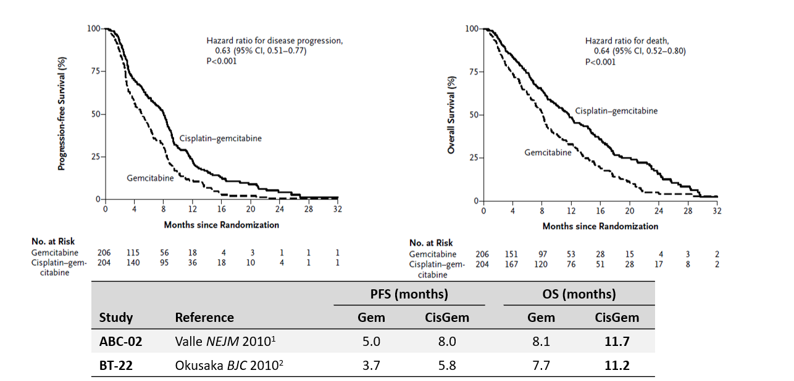
Standard first-line treatment option for Biliary tract cancers
Randomised phase 3 studies in advanced/metastatic bile duct cancer – gemcitabine ± cisplatin
1. Valle J, et al. N Engl J Med. 2010;362:1273–81. 2. Okusaka T, et al. Br J Cancer. 2010;103:469–74.

Slide 6

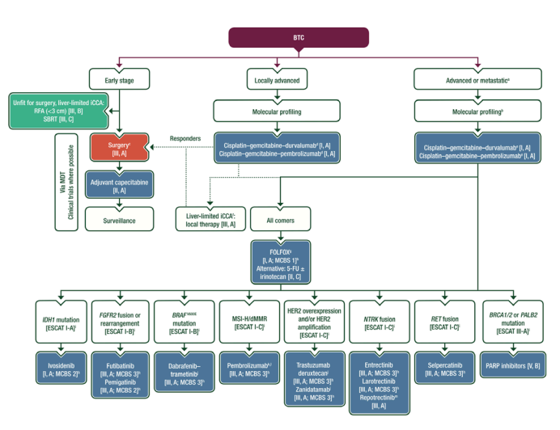
ESMO guidelines
5-FU, 5-fluorouracil; BTC, biliary tract cancer; CCA, cholangiocarcinoma; ChT, chemotherapy; dMMR, mismatch repair deficiency; EMA, European Medicines Agency; ESCAT, ESMO Scale for Clinical Actionability of molecular Targets; FDA, Food and Drug Administration; FOLFOX, 5-fluorouracil–leucovorin–oxaliplatin; HER2, human epidermal growth factor receptor 2; iCCA, intrahepatic cholangiocarcinoma; MCBS, ESMO-Magnitude of Clinical Benefit Scale; MDT, multidisciplinary team; MSI-H, microsatellite instability-high; PARP, poly (ADP-ribose) polymerase; PD-1, programmed cell death protein 1; RFA, radiofrequency ablation; SBRT, stereotactic body radiotherapy. ªClinical trial recommended when available. ^{b}Molecular profiling should be carried out before or during first-line therapy. Gene panel should include IDH1, FGFR2, BRAF, HER2,NTRK,RET, BRCA1/2 and PALB2 to test for hotspot mutations, but may also include genes such as c-MET. The rapidly evolving landscape of drug targets and predictive biomarkers may necessitate larger panels in the future. ^{c}Special considerations: (i) consider need for preoperative drainage; (ii) avoid percutaneous biopsy in resectable distal or perihilar CCA; (iii) assess future liver remnant; (iv) neoadjuvant approach (selected cases); (v) completion surgery for incidental gallbladder carcinoma stage ≥T1b. ^{d}Salvage surgery or local therapies should be considered in responding patients with initially inoperable disease. ^{e}Consider gemcitabine monotherapy in patients with compromised performance status or significant debility who are at risk of toxicity from platinum-containing ChT regimens. ^{f}Reconsider surgery in the event of adequate response to treatment. ^{g}Regimen without a specific licensed indication in BTC. ^{h}ESMO-MCBS v1.1²⁶ was used to calculate scores for therapies/indications approved by the EMA or FDA. The scores have been calculated and validated by the ESMO-MCBS Working Group and reviewed by the authors (https://www.esmo.org/guidelines/esmo-mcbs/esmo-mcbs-evaluation-forms). ^{i}ESCAT scores apply to alterations from genomic-driven analyses only. These scores have been defined by the authors and validated by the ESMO Translational Research and Precision Medicine Working Group.^{25j}FDA approved, not EMA approved. ^{k}Anti-PD-1 therapy is recommended for patients with MSI-H or dMMR who have not been treated with first-line immunotherapy. ^{l}EMA approved for MSI-H or dMMR BTC; FDA approved for all MSI-H or dMMR solid tumours. ^{m}Not EMA or FDA approved. Vogel A, Bridgewater J, Edeline J, Kelley RK, Klümpen HJ, Malka D, Primrose JN, Rimassa L, Stenzinger A, Valle JW, Ducreux M; ESMO Guidelines Committee. Biliary tract cancer: ESMO Clinical Practice Guideline for diagnosis, treatment and follow-up. Ann Oncol. 2024 Feb;34(2):127-140. doi:10.1016/j.annonc.2022.10.506

Slide 7
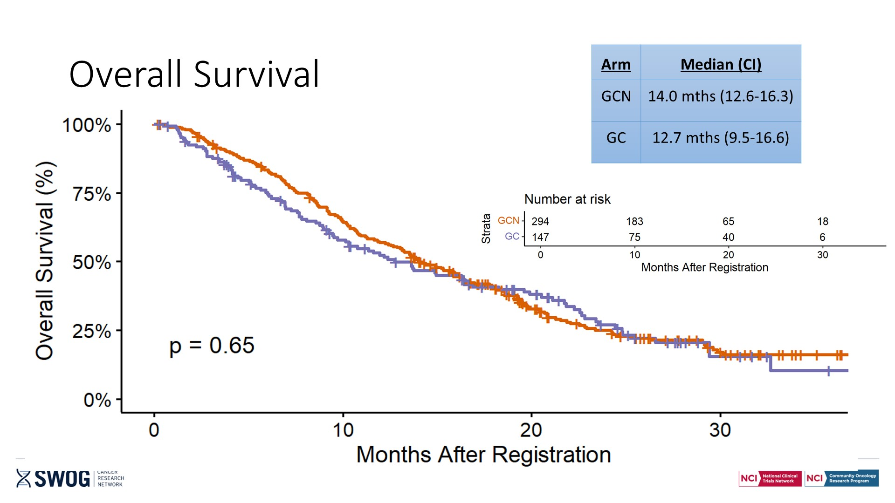
Triple therapy failed to demonstrated superiority to double therapy
SWOG S1815: A Phase III Randomized Trial of Gemcitabine,Cisplatin, and Nab-Paclitaxel Versus
Gemcitabine and Cisplatin in Newly Diagnosed, Advanced Biliary Tract Cancers
*
Overall Survival
Disease Site | GCN (CI) | GC (CI)
Intrahepatic CCA | 13.5 (11.7 to 16.1) | 13.6 (9.5 to 19.6)
Extrahepatic CCA | 15.9 (9.2 to 18.5) | 16.3 (5.1 to 29.4)
Gallbladder Adenocarcinoma | 17.0 (11.3 to 20.7) | 9.3 (7.0 to 22.2)
N 198/50/46
Overall Survival
Disease Stage | GCN (CI) | GC (CI)
Locally Advanced | 19.2 /16.3 to 24.3) | 13.7 (8.8 to 21.8)
Metastasic | 13.0 (10.6 to 14.3) | 13.6 (9.3 to 19.6)
Hazard ratio (HR), 0.91 (95% CI, 0.72 to 1.14); P = .41
N 77/217
Shroff et al, J Clin Oncol 2024
* Median OS with GAP was 14.0 months (95% CI, 12.4 to 16.1) and 13.6 months with GC (95% CI, 9.7 to 16.6)
Figura original al final

Slide 8
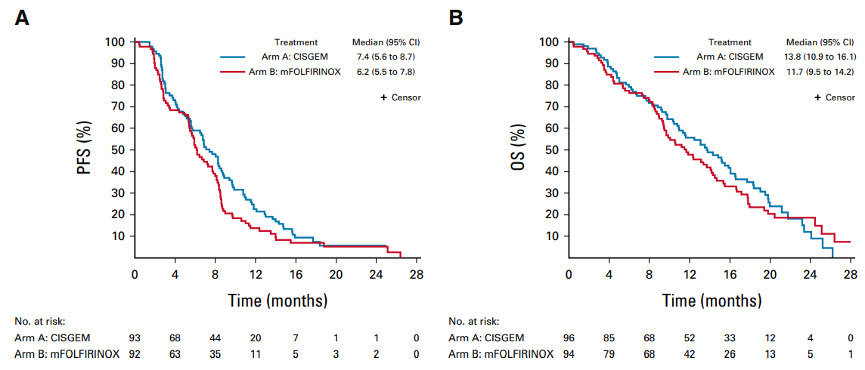
Triple therapy failed to demonstrated superiority to double therapy
Modified FOLFIRINOX Versus CISGEM Chemotherapy for Patients With Advanced Biliary Tract Cancer (PRODIGE 38 AMEBICA): A Randomized Phase II Study
Phelip JM, et al. J Clin Oncol. 2022;40(3):262-71

Slide 9
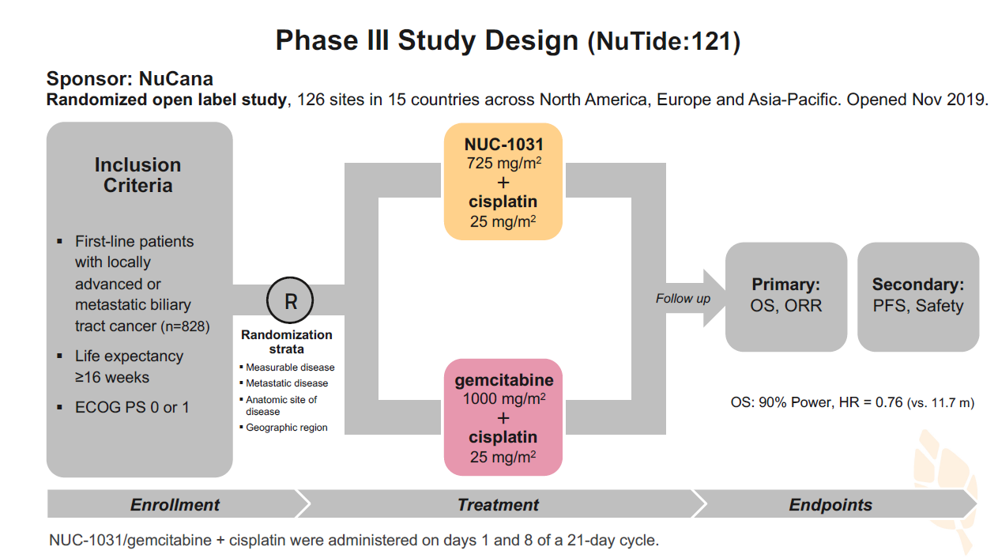
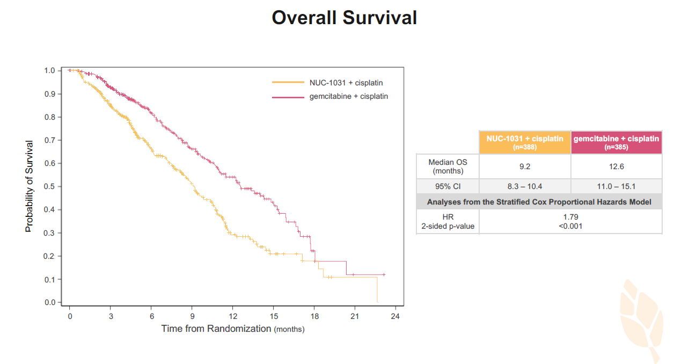
New chemotherapeutic drugs failed to demonstrated superiority to GemCis
Phase III study of CisGem +/- NUC-1031 for first-line treatment of patients with advanced BTC(NuTide:121)
In comparison to gemcitabine, NUC-1031 has:
Greater plasma stability (T1/2 8.3 hours vs 1.5 hours)
Increased intracellular levels of the active anti-cancer metabolite, dFdCTP (217x)
Knox et al, J Hepahol 2025

Slide 10
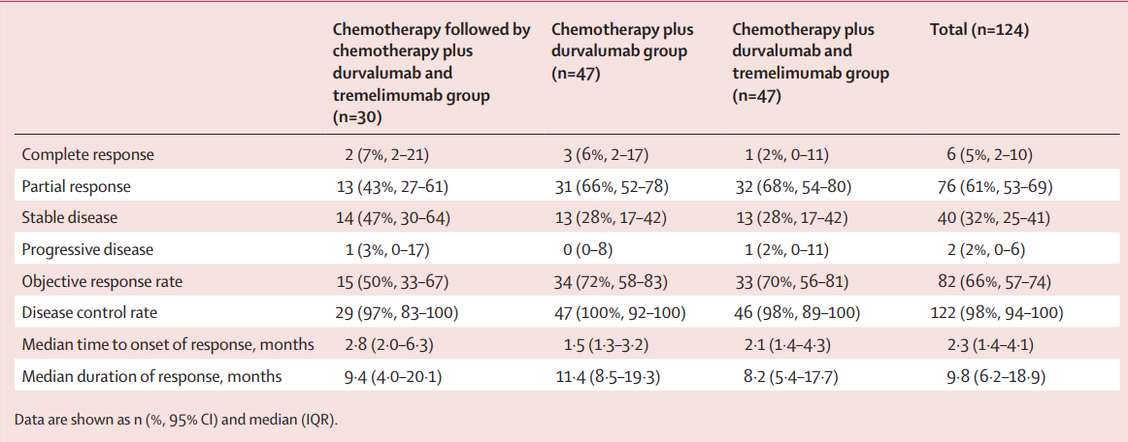
First Line Treatment in uBTC
Phase 2 CisGem + durvalumab +/- tremelimumab
Do-Youn Oh et al, Lancet Gastroenterol Hepatol 2022

Slide 11
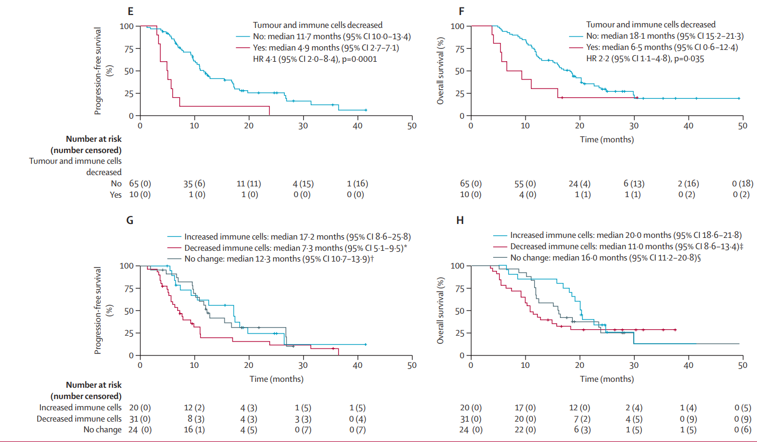
First Line Treatment in uBTC
Phase 2 CisGem + durvalumab +/- tremelimumab
Do-Youn Oh et al, Lancet Gastroenterol Hepatol 2022

Slide 12
First Line Treatment in uBTC
Clinical trials
Study population:
Adults with locally advanced or metastatic BTC*
Recurrent disease >6 months after curative surgery or adjuvant therapy completion†
Measurable lesion(s) by RECIST v1.1
ECOG PS 0 or 1
Durvalumab 1500 mg on day 1 Q3W
+ gemcitabine 1000 mg/m², and
cisplatin 25 mg/m² on days 1 and 8 Q3W [up to 8 cycles]¹
Durvalumab 1500 mg Q4W until PD, unacceptable toxicity or study withdrawal
R 1:1
N=685¹
TOPAZ-1^{1,2}
Placebo on day 1 Q3W
+ gemcitabine 1000 mg/m², and
cisplatin 25 mg/m² on days 1 and 8 Q3W [up to 8 cycles]¹
Placebo Q4W until PD, unacceptable toxicity or study withdrawal
Study population:
Adults with metastatic and/or unresectable (locally advanced) BTC
Measurable disease by RECIST v1.1
ECOG PS 0 or 1
No prior systemic therapy for advanced BTC
Pembrolizumab 200 mg on day 1 Q3W
+ gemcitabine 1000 mg/m², and
cisplatin 25 mg/m² on days 1 and 8 Q3W^{3,4}
Treatment to continue until:
PD, unacceptable toxicity or study withdrawal [for pembrolizumab and gemcitabine]
Up to 35 cycles [for pembrolizumab]
Up to 8 cycles [for cisplatin]
R 1:1
N=788³
KEYNOTE-966^{3–6}
Placebo on day 1 Q3W
+ gemcitabine 1000 mg/m², and
cisplatin 25 mg/m² on days 1 and 8 Q3W^{3,4}
1. Oh DY, et al, N Eng J Med Evidence 2022. 2. Kelley K et al. Lancet 2023

Slide 13
First Line Treatment in uBTC
Clinical trials
Study population:
Adults with locally advanced or metastatic BTC*
Recurrent disease >6 months after curative surgery or adjuvant therapy completion†
Measurable lesion(s) by RECIST v1.1
ECOG PS 0 or 1
Durvalumab 1500 mg on day 1 Q3W
+ gemcitabine 1000 mg/m², and
cisplatin 25 mg/m² on days 1 and 8 Q3W [up to 8 cycles]¹
Durvalumab 1500 mg Q4W until PD, unacceptable toxicity or study withdrawal
R 1:1
N=685¹
TOPAZ-1^{1,2}
Placebo on day 1 Q3W
+ gemcitabine 1000 mg/m², and
cisplatin 25 mg/m² on days 1 and 8 Q3W [up to 8 cycles]¹
Placebo Q4W until PD, unacceptable toxicity or study withdrawal
1. Oh DY, et al, N Eng J Med Evidence 2022. 2. Kelley K et al. Lancet 2023

Slide 14
First Line Treatment in uBTC
Clinical trials
Study population:
Adults with metastatic and/or unresectable (locally advanced) BTC
Measurable disease by RECIST v1.1
ECOG PS 0 or 1
No prior systemic therapy for advanced BTC
Pembrolizumab 200 mg on day 1 Q3W
+ gemcitabine 1000 mg/m², and
cisplatin 25 mg/m² on days 1 and 8 Q3W^{3,4}
Treatment to continue until:
PD, unacceptable toxicity or study withdrawal [for pembrolizumab and gemcitabine]
Up to 35 cycles [for pembrolizumab]
Up to 8 cycles [for cisplatin]
R 1:1
N=788³
KEYNOTE-966^{3–6}
Placebo on day 1 Q3W
+ gemcitabine 1000 mg/m², and
cisplatin 25 mg/m² on days 1 and 8 Q3W^{3,4}
1. Oh DY, et al, N Eng J Med Evidence 2022. 2. Kelley K et al. Lancet 2023

Slide 15
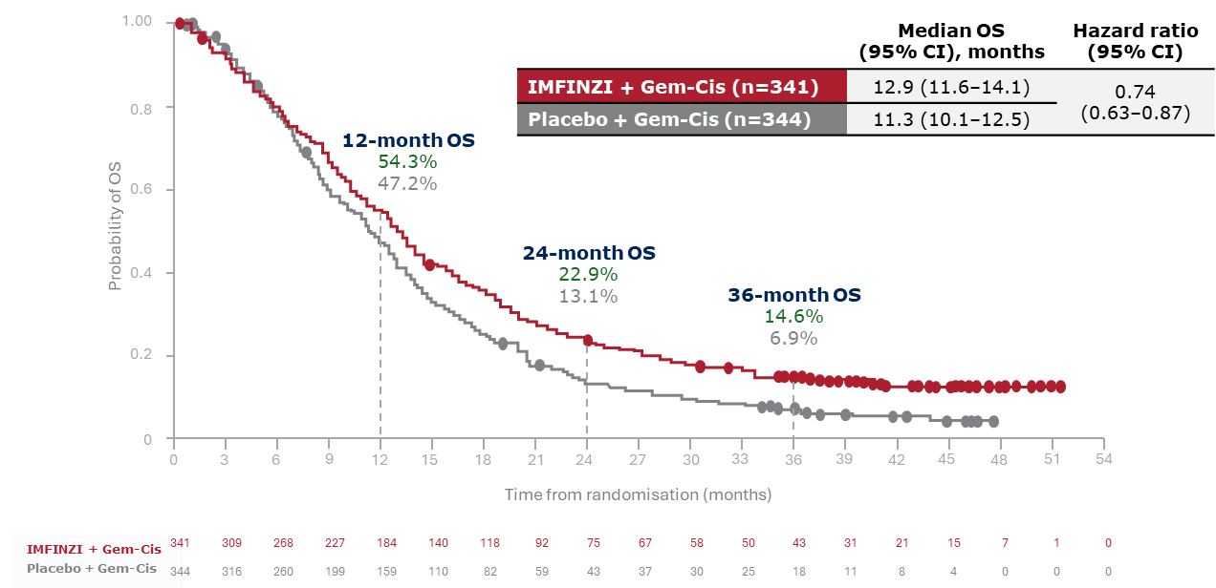
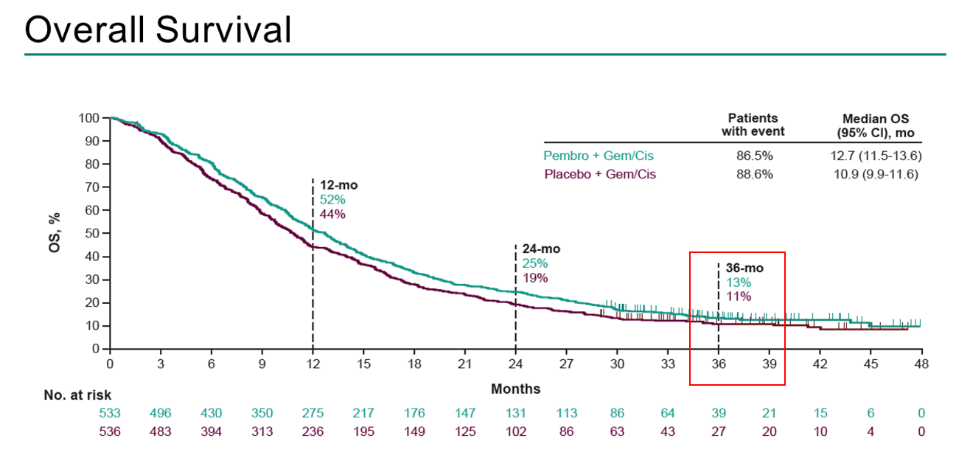
First Line Treatment in uBTC
Efficacy – Overall Survival
TOPAZ-1
KEYNOTE-966
1. Oh DY, et al, N Eng J Med Evidence 2022. 2. Finn et Al, ASCO 2024

Slide 16
First Line Treatment in uBTC
Efficacy – Overall Survival
TOPAZ-1
1. Oh DY, et al, N Eng J Med Evidence 2022. 2. Finn et Al, ASCO 2024

Slide 17
First Line Treatment in uBTC
Efficacy – Overall Survival
KEYNOTE-966
1. Oh DY, et al, N Eng J Med Evidence 2022. 2. Finn et Al, ASCO 2024

Slide 18
First Line Treatment in uBTC
Durvalumab plus GemCis continues to demonstrate a clinically meaningful and durable survival beneﬁt at 4 years
 | 4-year OS analysis DCO: 28 February 2025¹ |  | 3-year OS analysis DCO: 23 October 2023²
 | Durvalumab + GemCis (n=341) | Placebo + GemCis (n=344) | Durvalumab + GemCis (n=341) | Placebo + GemCis (n=344)
Median OS (95% CI), months | 13.0 (11.6–14.1) | 11.4 (10.1–12.5) | 12.9 (11.6–14.1) | 11.3 (10.1–12.5)
OS HR (95% CI) | 0.75 (0.64–0.88) | xx | 0.74 (0.63–0.87) | xx
100
90
80
70
60
Probability of OS (%)
50
24-month OS:
23.2 %
13.7%
40
36-month OS: 15.0 %
7.6 %
48-month OS:
11.8%
4.3 %
OS rate ratio=2.74
30
20
10
OS rate
ratio=1.69
Durvalumab + GemCis
OS data maturity across the durvalumab arm: 90.3%
OS rate ratio=1.97
0
Placebo + GemCis
0
3
6
9
12
15
18
21
24
27
30
33
36
39
42
45
48
51
54
57
60
63
66
69
No. of participants at risk
Time from randomisation (months)
Durvalumab + GemCis
341
310
269
228
185
142
120
94
77
69
60
52
48
44
39
38
36
34
26
20
14
8
4
0
Placebo + GemCis
344
318
262
201
161
112
84
61
45
39
32
27
23
19
18
15
13
10
7
6
4
0
0
0
4-year OS exploratory analysis¹ 1. Valle JW, et al. EASL Liver Cancer Summit 2026. Oral OS-3. 2. Oh DY, et al. J Hepatol 2025;83:1092–1101.

Slide 19
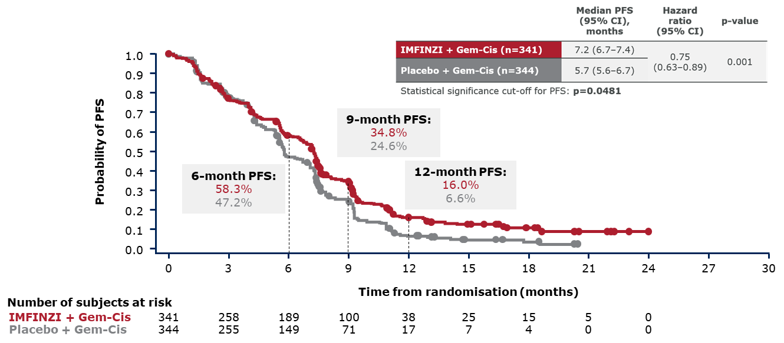
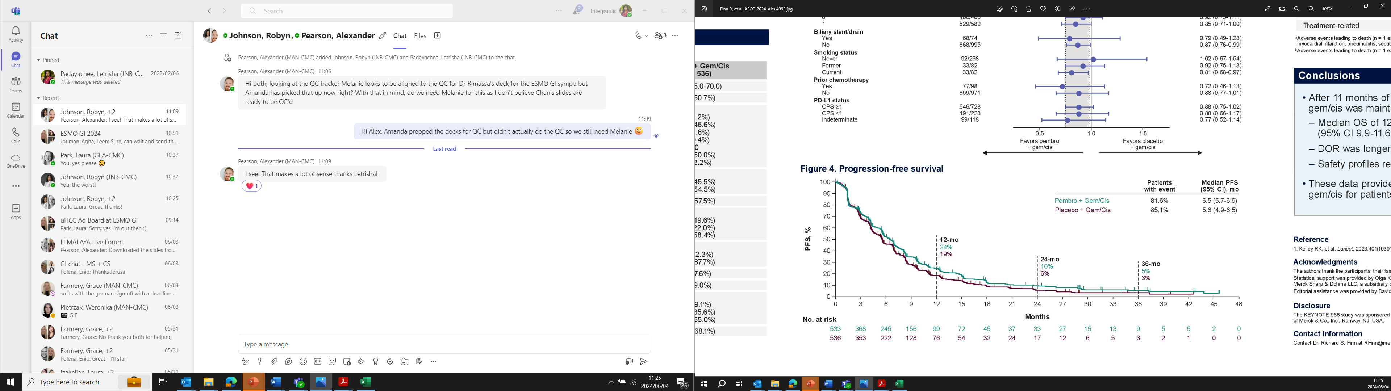
First Line Treatment in uBTC
Efficacy - SLP
TOPAZ-1
KEYNOTE-966
1. Oh DY, et al, N Eng J Med Evidence 2022 2. Finn et Al, ASCO 2024

Slide 20
First Line Treatment in uBTC
Efficacy - SLP
TOPAZ-1
1. Oh DY, et al, N Eng J Med Evidence 2022 2. Finn et Al, ASCO 2024

Slide 21
First Line Treatment in uBTC
Efficacy - SLP
KEYNOTE-966
1. Oh DY, et al, N Eng J Med Evidence 2022 2. Finn et Al, ASCO 2024

Slide 22
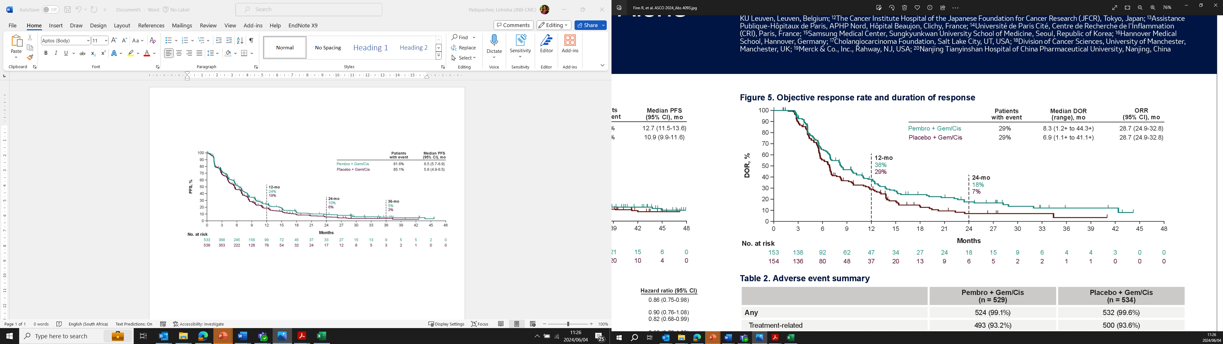
First Line Treatment in uBTC
Efficacy - ORR
*
TOPAZ-1
KEYNOTE-966
Event, n (%) | Durvalumab + Gem-Cis (n=341) | Placebo + Gem-Cis (n=343)
Respondersª | 91 (26.7) | 64 (18.7)
Complete response | 7 (2.1) | 2 (0.6)
Partial response | 84 (24.6) | 62 (18.1)
Non-responders | 250 (73.3) | 279 (81.3)
Stable disease | 200 (58.7) | 220 (64.1)
Progressive disease | 47 (13.8) | 51 (14.9)
Not evaluable | 3 (0.9) | 8 (2.3)
DoR: 6.4m vs 6.2 m
1. Oh D-Y, He AR, Bouattour M, Okusaka T, Qin S, Chen L-T, et al. Durvalumab or placebo plus gemcitabine and cisplatin in participants with advanced biliary tract cancer (TOPAZ-1): updated overall survival from a randomised phase 3 study. Lancet Gastroenterol Hepatol [Internet]. 2024;9(8):694–704. Disponible en: http://dx.doi.org/10.1016/S2468-1253(24)00095-5 Figura original al final de las diapositivas* 2. Finn et Al, ASCO 2024

Slide 23
First Line Treatment in uBTC
Efficacy - ORR
*
TOPAZ-1
Event, n (%) | Durvalumab + Gem-Cis (n=341) | Placebo + Gem-Cis (n=343)
Respondersª | 91 (26.7) | 64 (18.7)
Complete response | 7 (2.1) | 2 (0.6)
Partial response | 84 (24.6) | 62 (18.1)
Non-responders | 250 (73.3) | 279 (81.3)
Stable disease | 200 (58.7) | 220 (64.1)
Progressive disease | 47 (13.8) | 51 (14.9)
Not evaluable | 3 (0.9) | 8 (2.3)
DoR: 6.4m vs 6.2 m
1. Oh D-Y, He AR, Bouattour M, Okusaka T, Qin S, Chen L-T, et al. Durvalumab or placebo plus gemcitabine and cisplatin in participants with advanced biliary tract cancer (TOPAZ-1): updated overall survival from a randomised phase 3 study. Lancet Gastroenterol Hepatol [Internet]. 2024;9(8):694–704. Disponible en: http://dx.doi.org/10.1016/S2468-1253(24)00095-5 Figura original al final de las diapositivas* 2. Finn et Al, ASCO 2024

Slide 24
First Line Treatment in uBTC
Efficacy - ORR
*
KEYNOTE-966
1. Oh D-Y, He AR, Bouattour M, Okusaka T, Qin S, Chen L-T, et al. Durvalumab or placebo plus gemcitabine and cisplatin in participants with advanced biliary tract cancer (TOPAZ-1): updated overall survival from a randomised phase 3 study. Lancet Gastroenterol Hepatol [Internet]. 2024;9(8):694–704. Disponible en: http://dx.doi.org/10.1016/S2468-1253(24)00095-5 Figura original al final de las diapositivas* 2. Finn et Al, ASCO 2024

Slide 25
First Line Treatment in uBTC
AEs Profile
 | TOPAZ-1^{1–3}
 | Durvalumab + GemCis (n=338)* | Placebo + GemCis (n=342)*
Median (range) duration of study treatment, months | 7.3 (0.1–24.5) | 5.8 (0.2–21.5)
TRAEs, %
Any-grade TRAEs | 93 | 90
Serious TRAEs | 16 | 17
Grade 3 / 4 TRAEs | 63 | 65
Grade 5 TRAEs | 1† | <1†
TRAEs leading to discontinuation of any component | 9 | 11
imAEs, %
Any-grade imAEs | 13‡ | 5‡
Grade 3 / 4 imAEs | 2‡ | 2‡
imAEs requiring systemic corticosteroids | 8² | 4²
1. Oh DY, et al, N Eng J Med Evidence 2022. Figura original al final de las diapositivas*

Slide 26
First Line Treatment in uBTC
AEs Profile
 | 4-year OS analysis (DCO: 28 Feb 2025) |  | 3-year OS analysis (DCO: 23 Oct 2023)¹
 | Durvalumab + GemCis (n=338) | Placebo + GemCis (n=342) | Durvalumab + GemCis (n=338) | Placebo + GemCis (n=342)
Median (range) duration of durvalumab or placebo treatment, months | 7.3 (0.1–65.2) | 5.8 (0.2–28.4) | 7.3 (0.1–50.9) | 5.8 (0.2–28.4)
Median (range) duration of durvalumab or placebo combination therapy, months | 5.5 (0.1–9.0) | 5.5 (0.2–8.1) | – | –
Median (range) duration of durvalumab or placebo maintenance monotherapy, months | 3.7 (0.2–59.7) | 2.8 (0.6–22.6) | – | –
Mean (SD) duration of durvalumab or placebo treatment, months | 9.4 (10.7) | 6.3 (4.2) | 9.0 (8.9) | 6.3 (4.2)
SAEs, n (%) | 168 (49.7) | 152 (44.4) | 165 (48.8) | 152 (44.4)
Any SAE possibly related to study treatment*, n (%) | 52 (15.4) | 59 (17.3) | 52 (15.4) | 59 (17.3)
Any AE leading to discontinuation of durvalumab or placebo, n (%) | 21 (6.2) | 18 (5.3) | 21 (6.2) | 18 (5.3)
4-year OS exploratory analysis¹ 1. Valle JW, et al. EASL Liver Cancer Summit 2026. Oral OS-3. 2. Oh DY, et al. J Hepatol 2025;83:1092–1101.

Slide 27
First Line Treatment in uBTC
AEs Profile
 | KEYNOTE-966
 | Pembrolizumab + GemCis (n=529) | Placebo + GemCis (n=534)
Median (IQR) duration of study treatment, months | 6.4 (2.8–10.8) | 5.5 (2.5–9.7)
TRAEs, %
Any-grade TRAEs | 93 | 94
Grade 3 / 4 TRAEs | 70 | 69
Grade 5 TRAEs | 2 | 1
TRAEs leading to discontinuation of any component | 19 | 15
imAEs, %
Any-grade imAEs | 22* | 13*
Grade 3 / 4 imAEs | 7* | 4*
imAEs requiring systemic corticosteroids | 9 | 5
Kelley RK, et al. Lancet 2023;401:1853–1865.

Slide 28
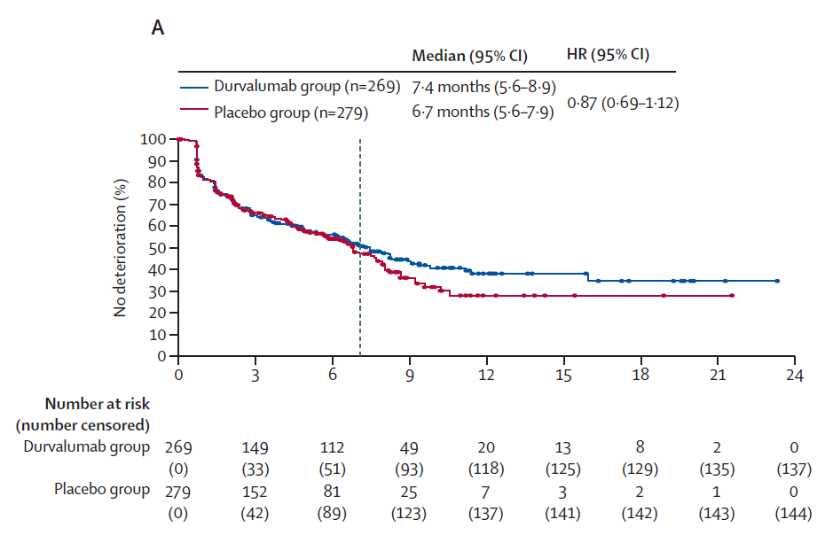
First Line Treatment in uBTC
Quality of Life in TOPAZ-1 Trial
Time to deterioration of global health status or QOL by treatment group overall TOPAZ-1
.
1. Burris et al, Lancet Oncol 2024.

Slide 29
First Line Treatment in uBTC
Durvalumab plus GemCis is generally effective in participants with clinically actionable and high-prevalence genomic alterations
Events, n / N (%)
 |  |  | Durvalumab + GemCis | Placebo + GemCis | HR (95% CI)
BEP |  |  | 151 / 214 (70.6) | 181 / 227 (79.7) | 0.76 (0.61–0.94)
TP53 | Wild-type |  | 74 / 111 (66.7) | 85 / 115 (73.9) | 0.78 (0.57–1.07)
 | Alteration |  | 77 / 103 (74.8) | 96 / 112 (85.7) | 0.74 (0.55–1.00)
CDKN2A / B / MTAP loss | Wild-type |  | 112 / 164 (68.3) | 131 / 166 (78.9) | 0.71 (0.55–0.91)
 | Alteration |  | 39 / 50 (78.0) | 50 / 61 (82.0) | 0.95 (0.62–1.45)
KRAS | Wild-type |  | 110 / 158 (69.6) | 139 / 177 (78.5) | 0.81 (0.63–1.04)
 | Alteration |  | 41 / 56 (73.2) | 42 / 50 (84.0) | 0.55 (0.35–0.86)
ARID1A | Wild-type |  | 120 / 174 (69.0) | 145 / 175 (82.9) | 0.66 (0.52–0.85)
 | Alteration |  | 31 / 40 (77.5) | 36 / 52 (69.2) | 1.22 (0.75–1.99)
IDH1 | Wild-type |  | 139 / 192 (72.4) | 172 / 210 (81.9) | 0.77 (0.61–0.96)
 | Alteration |  | 12 / 22 (54.5) | 9 / 17 (52.9) | 0.76 (0.31–1.89)
ERBB2 amplification* | Wild-type |  | 138 / 199 (69.3) | 165 / 207 (79.7) | 0.72 (0.57–0.90)
 | Alteration |  | 13 / 15 (86.7) | 16 / 20 (80.0) | 1.71 (0.82–3.56)
BRCA1 / 2 | Wild-type |  | 147 / 203 (72.4) | 175 / 219 (79.9) | 0.78 (0.62–0.97)
 | Alteration |  | 4 / 11 (36.4) | 6 / 8 (75.0) | NC‡
FGFR2 rearrangement | Wild-type |  | 149 / 210 (71.0) | 173 / 216 (80.1) | 0.76 (0.61–0.95)
 | Alteration |  | 2 / 4 (50.0) | 8 / 11 (72.7) | NC‡
BRAF | Wild-type |  | 144 / 206 (69.9) | 173 / 219 (79.0) | 0.76 (0.61–0.95)
 | Alteration |  | 7 / 8 (87.5) | 8 / 8 (100.0) | NC‡
Generally, similar OS benefit with durvalumab versus placebo was observed for participants with either wild-type or altered genotypes
95% CIs are wide for some genomic alterations due to low prevalence
Genomic alteration
0.062
0.125
0.250
0.500
1.00
2.00
4.00
8.00
16.00
Favours durvalumab + GemCis
Favours placebo + GemCis
OS HR (95% CI)†
1. Oh D-Y, et al. Presented at: ESMO Asia Congress 2022; 2–4 December 2022; Singapore. Oral presentation 68O.

Slide 30
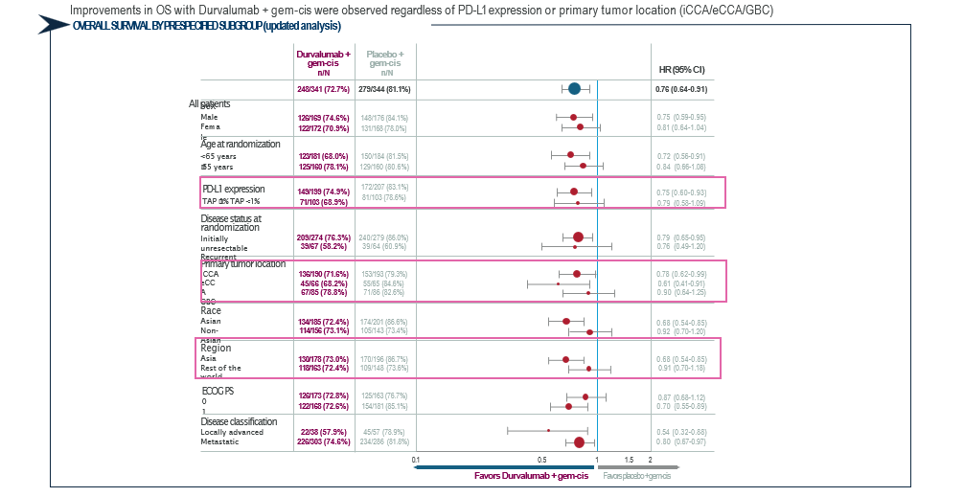
First Line Treatment in uBTC
Durvalumab plus GemCis is generally effective all prespecified subgroups
Topaz-1 trial
Oh DY, et al. Updated overall survival from the Phase 3 TOPAZ-1 study of durvalumab or placebo plus gemcitabine and cisplatin in patients with advanced biliary tract cancer. Poster presented at ESMO 2022

Slide 31
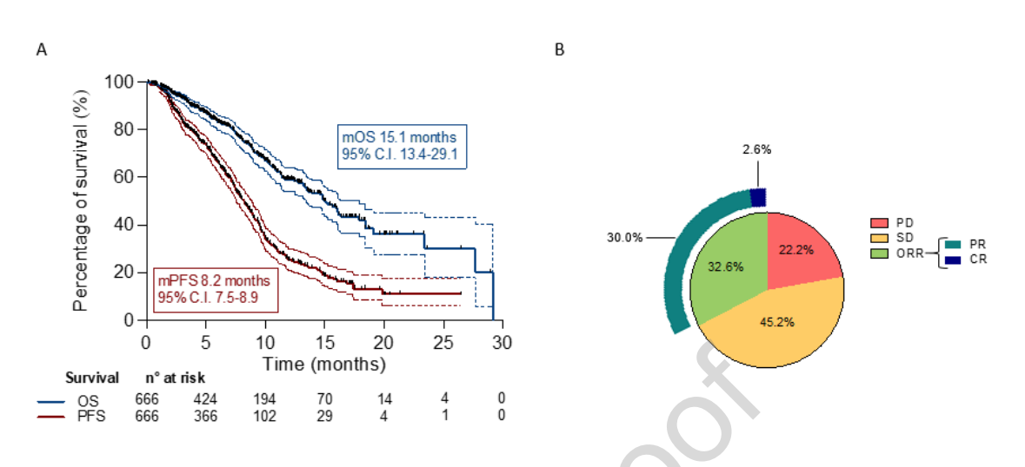
International RWE supports the use of
Durvalumab + gem-cis
666 patients were enrolled at 39 sites in 11 countries (Italy, Germany, Austria, Spain, United Kingdom, US, South Korea, China, Hong Kong Special Administrative Region of China, Japan and Belgium).
Median PFS was 8.2 months (95% CI: 7.5-8.9), and median OS 15.1 months (95% CI: 13.4-29.1).
The investigator-assessed ORR was 32.6%.
Rimini et al, Eur J Cancer 2024

Slide 32
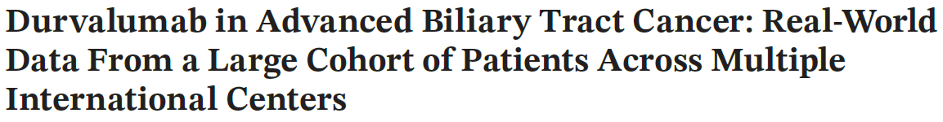
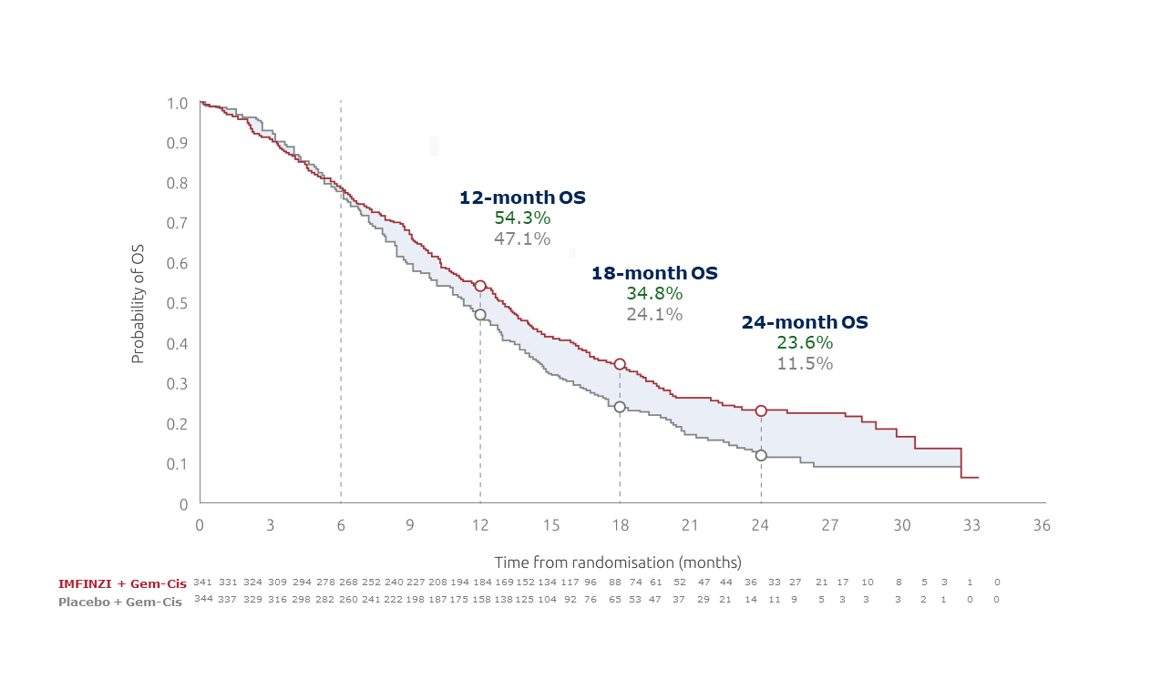
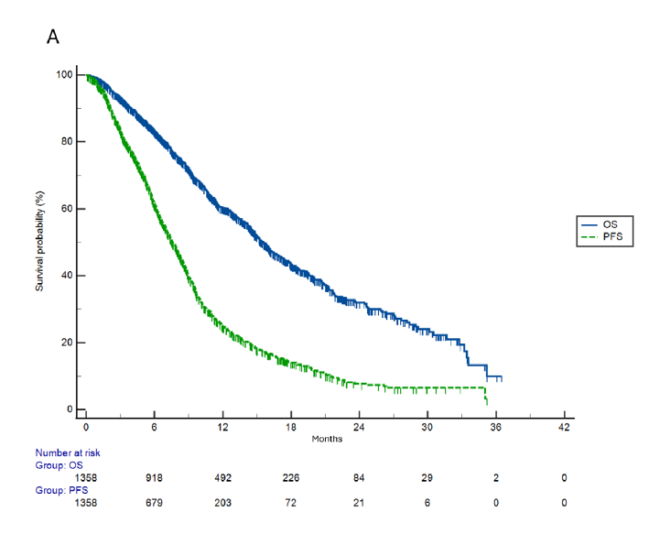
First Line Treatment in uBTC
International RWE supports the use of Durvalumab + gem-cis
1358 pacientes
Incluye Población Española
mOS: 12.9 meses⁺
mOS: 15.6 meses
Ver figura original al final del material
mOS: mediana de supervivencia global; mSLP: mediana de supervivencia libre de progresión
1. Oh D-Y, He AR, Qin S, Chen L-T, Okusaka T, Kim JW, et al. Durvalumab plus chemotherapy in advanced biliary tract cancer: 3-year overall survival update from the phase III TOPAZ-1 study. J Hepatol [Internet]. 2025; Disponible en: http://dx.doi.org/10.1016/j.jhep.2025.05.003
2. 1.Rimini M, Fornaro L, Ikeda M, Abidoye O, Lucchetti J, Antonuzzo L, et al. Durvalumab in Advanced Biliary Tract Cancer: Real-World Data From a Large Cohort of Patients Across Multiple International Centers. Liver international : official journal of the International Association for the Study of the Liver [Internet]. 2025 Dec;45(12):e70428. Available from: https://pubmed.ncbi.nlm.nih.gov/41221651/
‌Estudio multicéntrico (39 centro en 11 paises distribuidos entre Europa, Asia y Estados Unidos),
retrospectivo, de vida real Cohorte de 666 pacientes con cáncer de vías biliares irresecable, localmente avanzado o metastático: colangiocarcinoma intrahepático, extrahepático y tumor de la vesícula biliar Objetivo primario: SG y SLP Objetivos secundarios: tasa de respuesta global (TRG), seguridad ² *n=222 + (11.6–14.1)
 | TOPAZ-1¹ | RWE Cohorte Global² | LIVER-R⁴
mOS | 12.9 | 15.1 | 15.6
mSLP | 7.2 | 8.2 | 8.2
Respuestas | 26.1 | 32.6 | No reportado

Slide 33
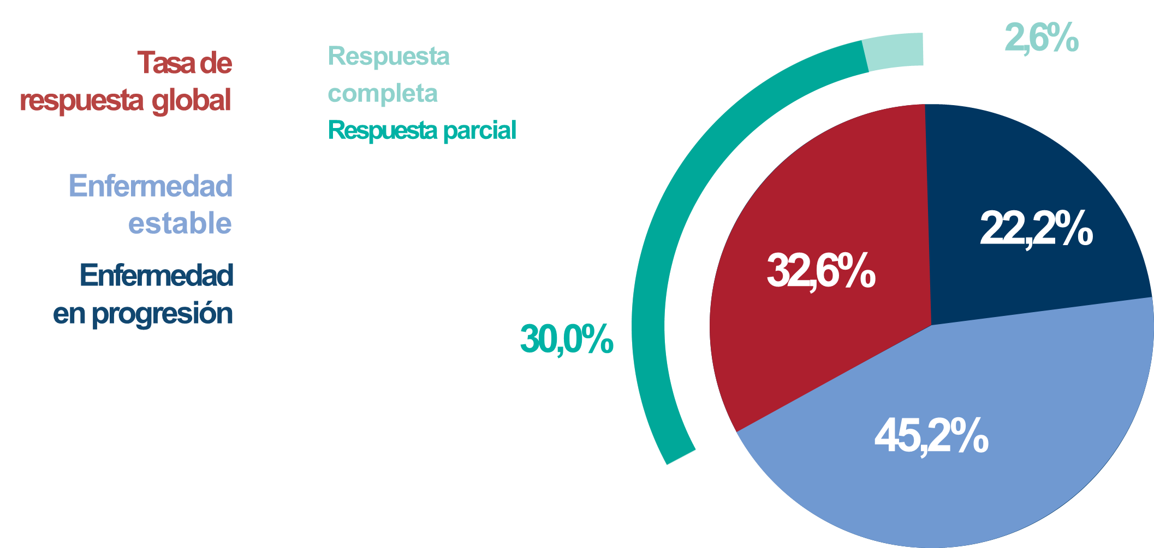
First Line Treatment in uBTC
International RWE supports the use of Durvalumab + gem-cis
1358 pacientes
Incluye Población Española
 | IMFINZI + Gem-Cis (n=341) | Placebo + Gem-Cis (n=343)
ORR, n (%) | 91 (26.7) | 64 (18.7)
Complete response, n (%) | 7 (2.1) | 2 (0.6)
Partial response, n (%) | 84 (24.6) | 62 (18.1)
Disease control rate, n (%) | 291 (85.3) | 284 (82.6)
2,2%
33,4%
35,6%
33,4%
47.1%
mOS: mediana de supervivencia global; mSLP: mediana de supervivencia libre de progresión
1. Oh D-Y, He AR, Qin S, Chen L-T, Okusaka T, Kim JW, et al. Durvalumab plus chemotherapy in advanced biliary tract cancer: 3-year overall survival update from the phase III TOPAZ-1 study. J Hepatol [Internet]. 2025; Disponible en: http://dx.doi.org/10.1016/j.jhep.2025.05.003
2. 1.Rimini M, Fornaro L, Ikeda M, Abidoye O, Lucchetti J, Antonuzzo L, et al. Durvalumab in Advanced Biliary Tract Cancer: Real-World Data From a Large Cohort of Patients Across Multiple International Centers. Liver international : official journal of the International Association for the Study of the Liver [Internet]. 2025 Dec;45(12):e70428. Available from: https://pubmed.ncbi.nlm.nih.gov/41221651/
‌
 | TOPAZ-1¹ | RWE Cohorte Global² | LIVER-R⁴
mOS | 12.9 | 15.1 | 15.6
mSLP | 7.2 | 8.2 | 8.2
Respuestas | 26.1 | 32.6 | No reportado

Slide 34
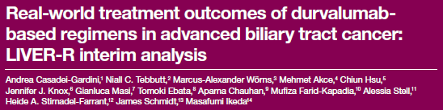
First Line Treatment in uBTC
International RWE supports the use of Durvalumab + gem-cis*
88.8% de población Europea
TOPAZ-1¹
LIVER-R²
mOS
12.8 (11.1-14.0)
15.6 (11.7-NE)
OS (24 meses)
24.9 (17.9-32.5)
34.2 (17.0-52.2)
mSLP
7.2 (6.7-7.4)
8.2 (7.1-NE)
ORR
26.1
No reportado
EAs Serios
47.3
18.2
EAs Inmunomediados
12.7
No reportado
EAs: Efectos adversos; mOS: mediana de supervivencia global; mSLP: mediana de supervivencia libre de progresión; OS: supervivencia global
1. Oh D-Y, et al. NEJM Evid. 2022;1(8). 2. Real-world treatment outcomes of durvalumab- based regimens in advanced biliary tract cancer: LIVER-R interim analysis. Presented at ESMO GI 2-5 July 2025 Barcelona.
*En este análisis inicial del estudio LIVER-R, se incluyeron 125 pacientes con aBTC. La mayoría eran hombres, mayores de 65 años, procedentes de Europa y con aBTC no resecable quirúrgicamente. La mayoría de los pacientes recibieron durvalumab en combinación con GemCis y continuaban su tratamiento en el punto de corte del análisis inicial. Los resultados muestran que los tratamientos basados en durvalumab parecen ser efectivos en la práctica clínica real y se alinean con los datos del ensayo clínico TOPAZ-1.

Slide 35
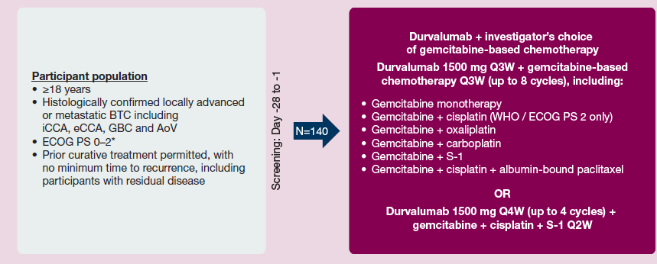
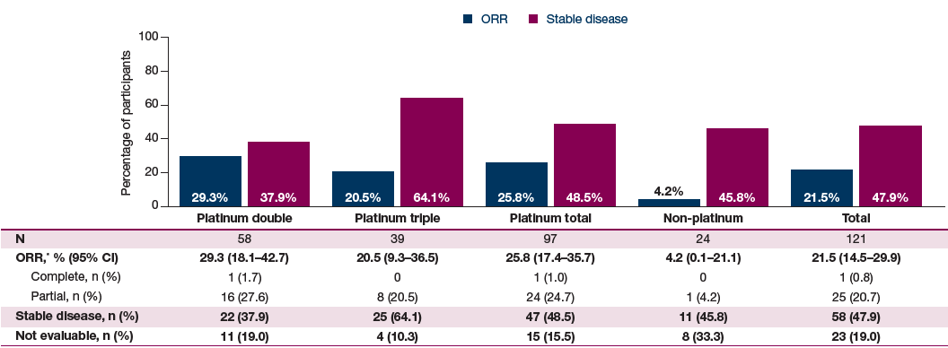
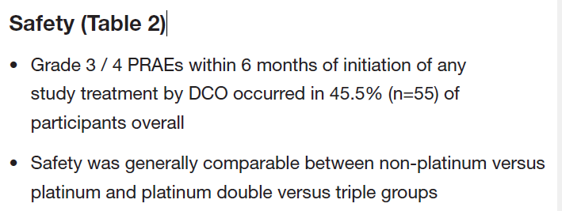
First Line Treatment in uBTC
Phase 3b TOURMALINE study durva in combination with gem-based chemo
ORR
Primary endpoint: number of participants with Grade 3 / 4 possibly related adverse events within 6 months of treatment initiation
Do-Youn Oh et al, ESMO GI 2025

Slide 36
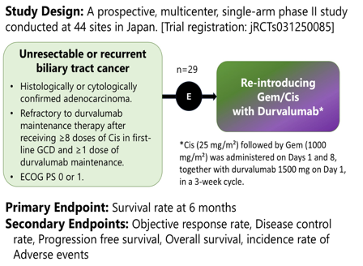
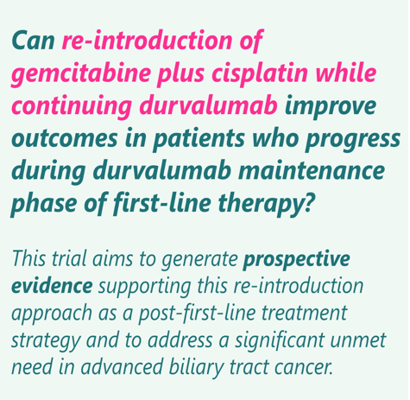
First Line Treatment in uBTC
GemCis re-introduction while continuing durvalumab
Takeda et al, TPS 609 presented ASCO GI 2026

Slide 37
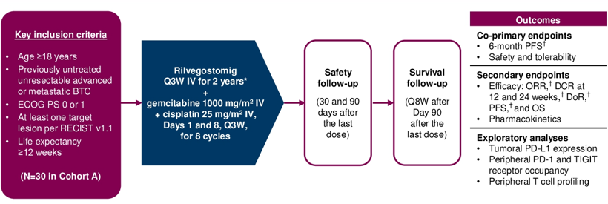
New potential IO combinations can be stablished as a new standard therapy in first line
GEMINI-Hepatobiliary substudy 2 Cohort A
*Or until disease progression, unacceptable toxicity, withdrawal of consent, or fulfilment of another discontinuation criterion; †Investigator-assessed per RECIST v1.1.
BTC, biliary tract cancer; DCR, disease control rate; DoR, duration of response; ECOG PS, Eastern Cooperative Oncology Group performance status; IV, intravenous; OS, overall survival; ORR, objective response rate; PD-1, programmed cell death protein-1; PD-L1, programmed cell death ligand-1; PFS, progression-free survival; Q3W, every 3 weeks; Q8W, every 8 weeks; RECIST, Response Evaluation Criteria in Solid Tumors; TIGIT, T cell immunoreceptor with immunoglobulin and ITIM domain
Zhou et al, presented at ASCO 2025

Slide 38
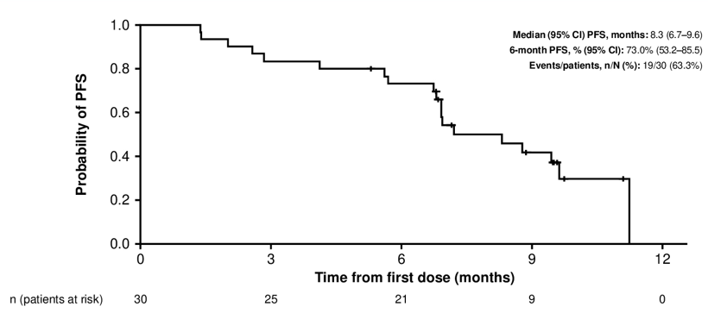
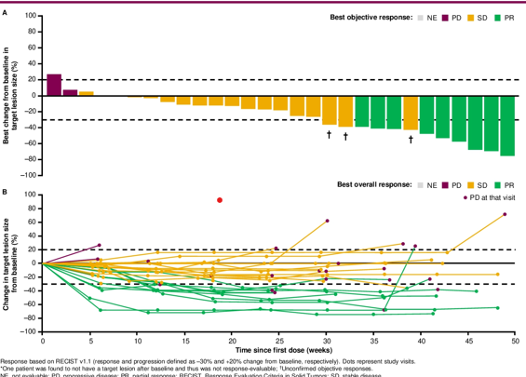
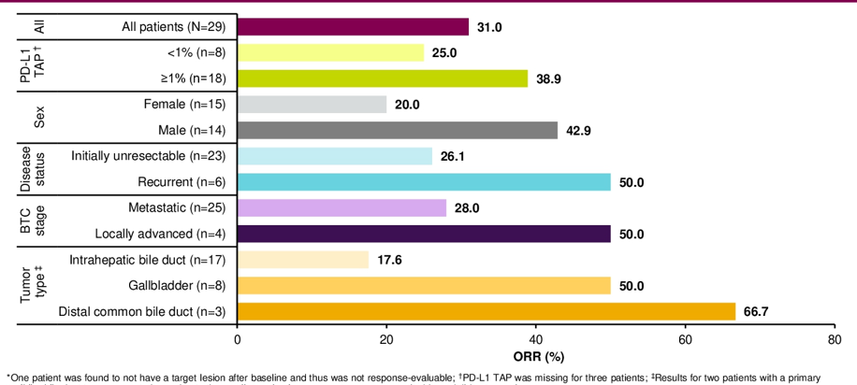
New potential IO combinations can be stablished as a new standard therapy in first line
Zhou et al, presented at ASCO 2025

Slide 39
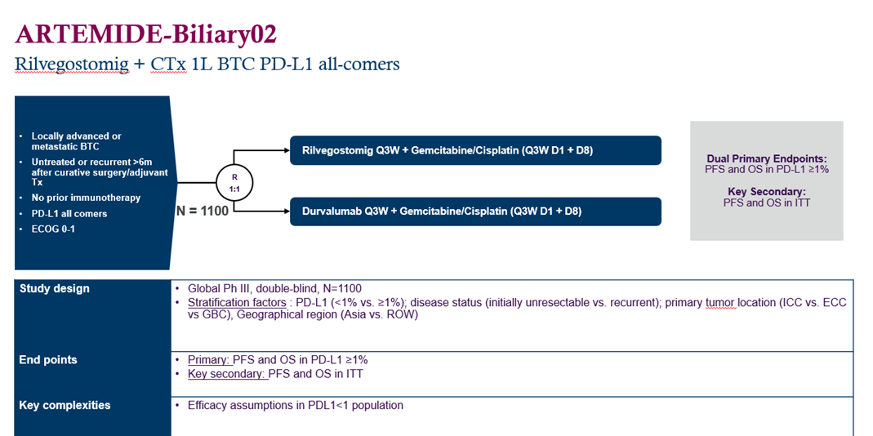
New potential IO combinations can be stablished as a new standard therapy in first line
NCT07221253
Clinicaltrials.gov [Internet]. Clinicaltrials.gov. [citado el 5 de marzo de 2026]. Disponible en: https://clinicaltrials.gov/study/NCT07221253

Slide 40
Targeted therapy potentially can be incorporate to the standard first line therapy IDH1 mut
Phase 1b/2 study of ivosidenib plus durvalumab and Gemcitabine/Cisplatin as First-line therapy in patients with advanced Cholangiocarcinoma and IDH1 mutation
NCT06501625
Clinicaltrials.gov [Internet]. Clinicaltrials.gov. [citado el 5 de marzo de 2026]. Disponible en: https://clinicaltrials.gov/study/NCT07221253

Slide 41
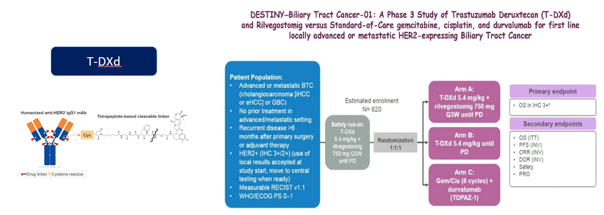
Targeted therapy potentially can be incorporate to the standard first line therapy Her2+
1.Yosihaki Nakamura, OP ASCO 2023; 2. Harding et al. Nat Commun. 2023 Feb 6;14:630

Slide 42
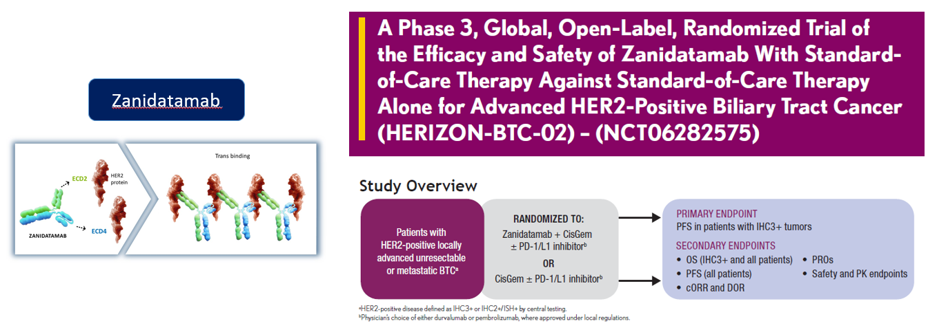
Targeted therapy potentially can be incorporate to the standard first line therapy Her2+
1. Harding et al. Nat Commun. 2023 Feb 6;14:630

Slide 43
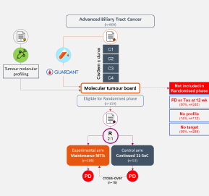
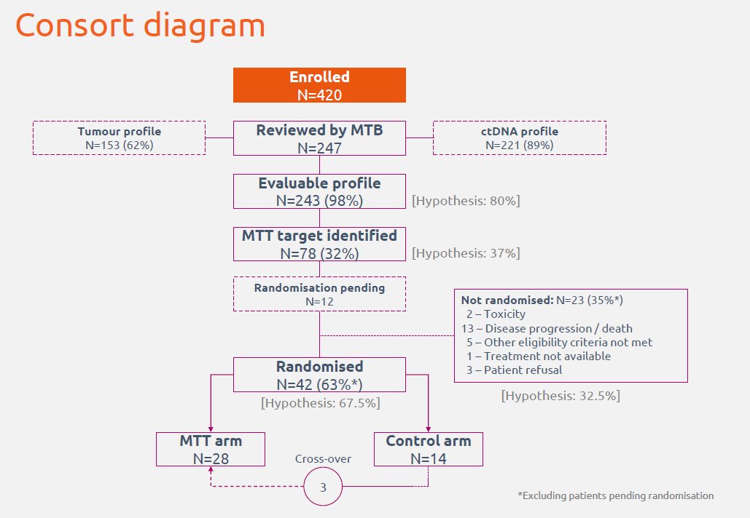
Maintenance strategy with target therapies potentially can be incorporate to the standard first line therapy
SAFIR ABC 10
Primary objective: PFS
Malka et al, ESMO 2025

Slide 44
Take home message
BTC is an heterogeneous group of patients¹
IO has changed the 1L treatment landscape in uBTC²
Combination with Targeted therapies has been evaluated^{3,4}
SAFIR ABC-10 is an academic trial that tested the maintenance strategy with Targeted therapies in 1L⁵
New mechanism of action regarding IO has been tested⁶
1. Macarulla et al. J Clin Oncol. 2026; 44(2_suppl): DOI: 10.1200/JCO.2026.44.2_suppl.503. Datos del registro RETUD. 2. Vogel A, Bridgewater J, Edeline J, Kelley RK, Klümpen HJ, Malka D, Primrose JN, Rimassa L, Stenzinger A, Valle JW, Ducreux M; ESMO Guidelines Committee. Biliary tract cancer: ESMO Clinical Practice Guideline for diagnosis, treatment and follow-up. Ann Oncol. 2024 Feb;34(2):127-140. doi:10.1016/j.annonc.2022.10.506 3. Yosihaki Nakamura, OP ASCO 2023; 4. Harding et al. Nat Commun. 2023 Feb 6;14:630 Clinicaltrials.gov [Internet]. Clinicaltrials.gov. [citado el 5 de marzo de 2026]. Disponible en: https://clinicaltrials.gov/study/NCT07221253 5. Malka et al, ESMO 2025 6. Clinicaltrials.gov [Internet]. Clinicaltrials.gov. [citado el 5 de marzo de 2026]. Disponible en: https://clinicaltrials.gov/study/NCT07221253

Slide 45




Slide 46


Slide 47
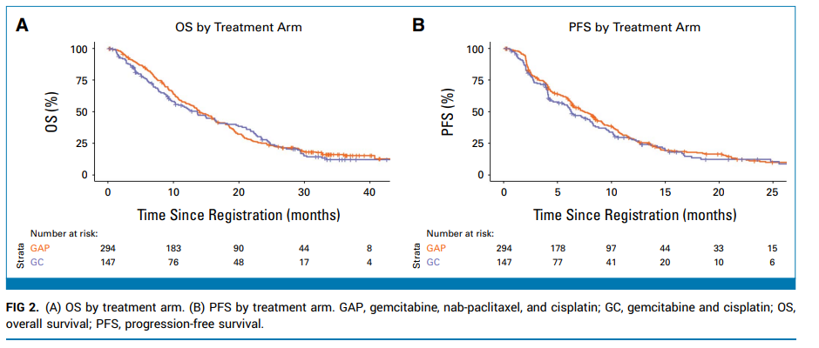
Figura Original Slide 7

Slide 48
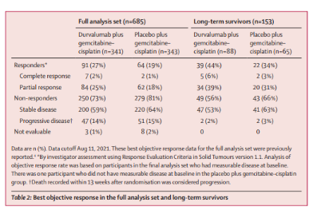
Figura Original Slide 16

Slide 49
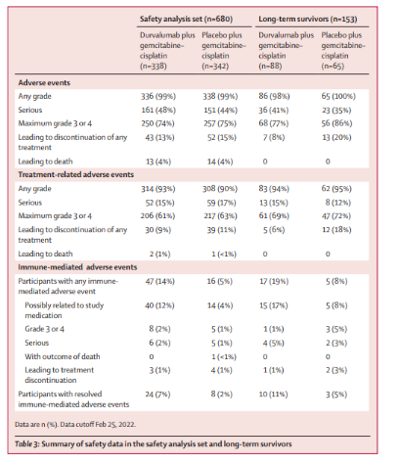
Figura Original Slide 17

Slide 50
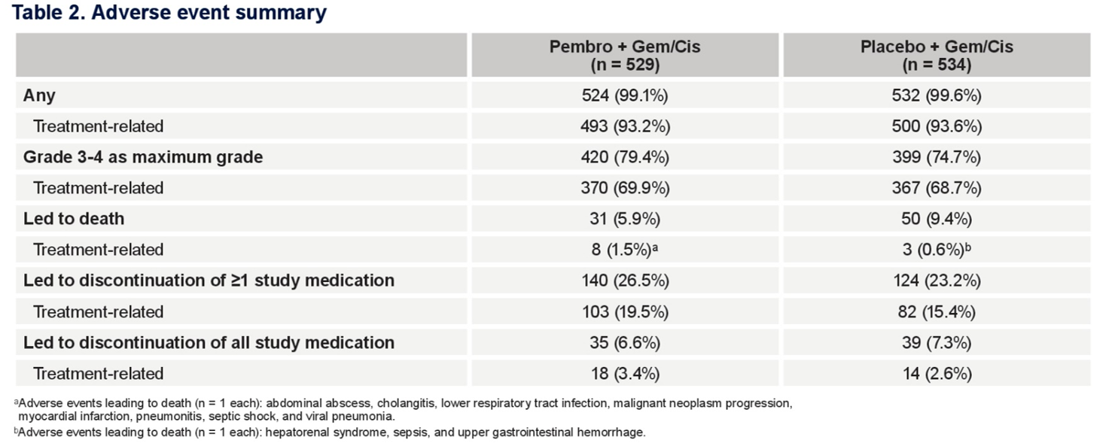
Figura Original Slide 18

Slide 51
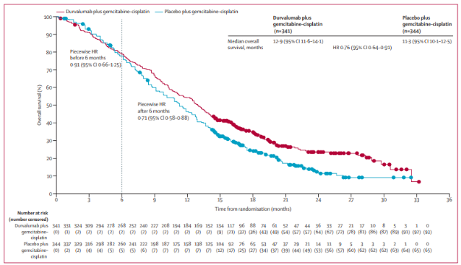
Figura Original Slide 32

