Slide 1
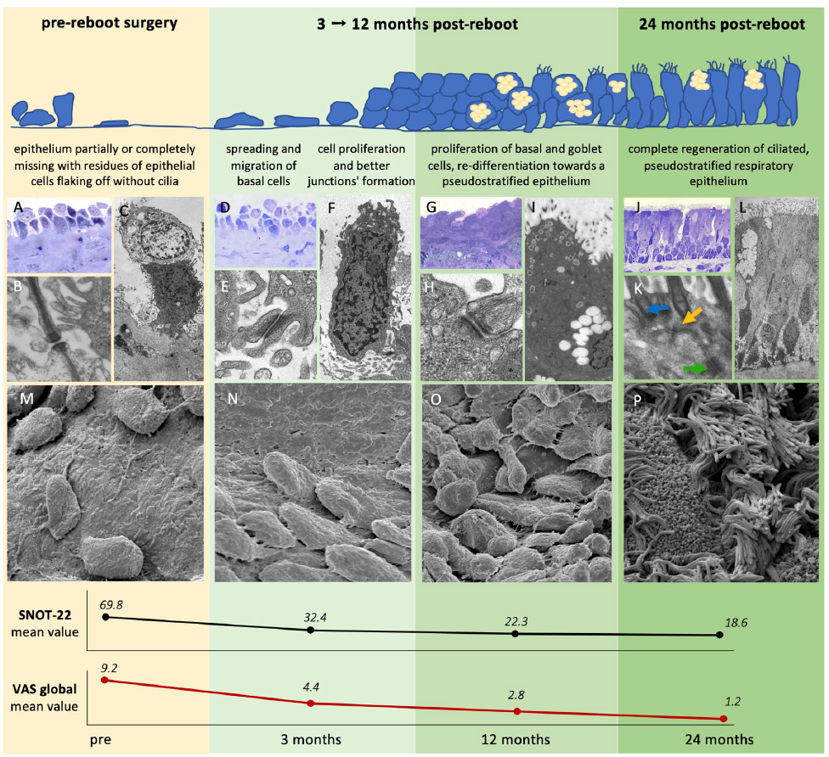
El epitelio se regenera después de cirugía Reboot, pero no siempre de manera correcta¹
La enfermedad de las mucosas y los síntomas que la acompañan pueden persistir o reaparecer rápidamente en los casos graves, debido a las citocinas y las células inflamatorias que perpetúan el proceso inflamatorio¹
Pirola F, et alL. Nasal Mucosa Regeneration After Reboot Surgery: Electron Microscopy and Histology Insights in CRSwNP. Laryngoscope. 2025 Sep;135(9):3082-3092
Notes:
Respiratory epithelium regeneration process after reboot surgery. The image illustrates the restoration pathway of the respiratory
epithelium over time. Histological sections and electron microscopy are reported to show the morphological and functional changes that accompany clinical improvement. (A–C, M) Presurgery: The epithelium is partially or completely absent, with residual epithelial cells lacking cilia. (D–I, N, O) 3–12 months post-reboot: Migration of basal cells, cell proliferation, junction formation, and reorganization toward a pseudostratified epithelium are observed. (J–L, P) 24 months post-reboot: Complete regeneration of the ciliated, pseudostratified respiratory epithelium with formed intercellular junctions (blue arrow = tight junction; yellow arrow = adherens junction; green arrow = desmosome). The results of the SNOT-22
and VAS are reported in the panel at the bottom of the figure.

